Slide 1
School Name SPECIAL TEAMS
LOGO
#Moto

Slide 2
SPECIAL TEAMS
It is our job on special teams to change the outcome of the game! Kick or punt return for Touchdowns, a punt downed inside the 20, turnovers on punt, or onside kick are all ways we will change momentum!
As special teams we WILL change the outcome of the game!
We are GAMECHANGERS!

Slide 3
Kickoff Return
#WEWILLWIN
#GAMECHANGERS
LOGO

Slide 4
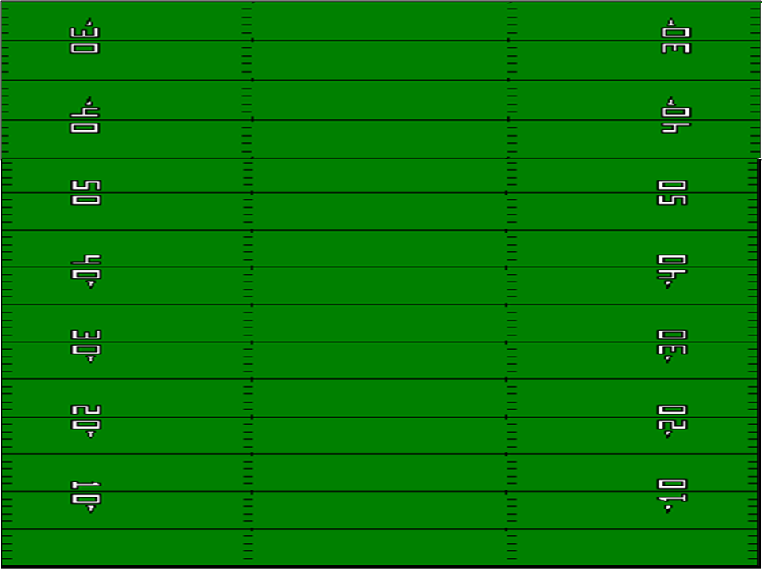
KOR – Alignment vs. HUDDLE
When they break Huddle – Move to Return Alignment – Keep eyes to Kicker
1
2
3
4
5
10
9
8
7
6
k
LT
LG
C
RG
RT
LE
RE
LM
RM
LR
RR
LT | LG | C | RG | RT | LE | LM | RM | RE | LR | RR
Align on the 48 YL. On the Hash Ready for Onside | Align on the 48 YL. Inside Hash. Ready for Onside | Align on the 48 YL to RT or LT of ball. Ready for Onside. | Align on the 48 YL. Inside the Hash. Ready for Onside | Align on the 48 YL. On the Hash Ready for Onside | Align on the 44 YL. Between Hash & #’s Ready for Pop | Align on the 40 YL. Inside the Hash. Ready for Pop-Squib | Align on the 40 YL. Bottom of the #’s. Ready for Pop | Align on the 44 YL. Inside the Hash. Ready for Pop-Squib | Align on 20 on Hash. Ready for Pop | Align on 20 on Hash. Ready for Pop.

Slide 5
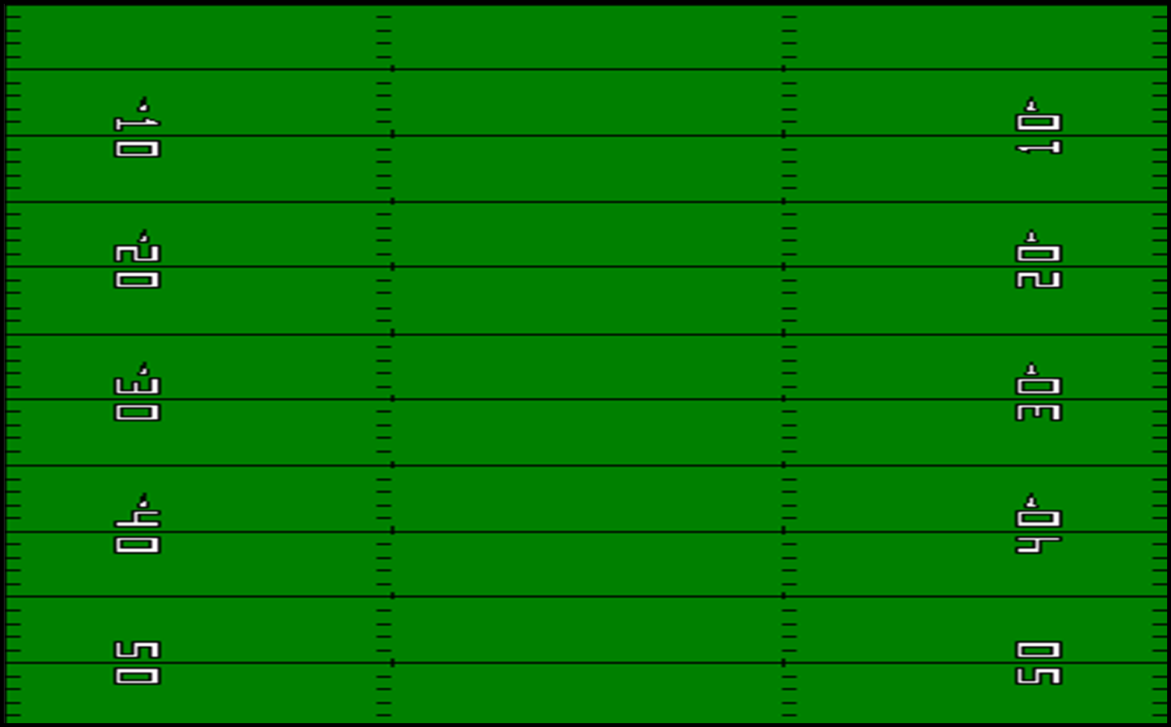
KICKOFF RETURN – Alignment – Break Huddle
LT
LG
C
RG
RT
LE
RE
LM
RM
LR
RR
LT | LG | C | RG | RT | LE | LM | RM | RE | LR | RR
Align on the 48 YL. Bottom of the #’s | Align on the 48 YL. Outside the Hash. | Align on the 48 YL. Even with the ball | Align on the 48 YL. Outside the the Hash. | Align on the 48 YL. Bottom of the #’s | Align on the 30 YL. Top of the #’s | Align on the 25 YL. Inside the Hash. | Align on the 25 YL. Inside the Hash. | Align on the 30 YL. Top of the #’s | 5 yard line. Outside the Hash | 5 yard line. Outside the Hash

Slide 6
KICKOFF RETURN – Catch Assignment
LT
LG
C
RG
RT
LE
RE
LM
RM
LR
RR
LT | LG | C | RG | RT | LE | LM | RM | RE | LR | RR
Ball off Tee - Onside kick Alert – Ball over Head set up return | Ball off Tee - Onside kick Alert -Ball over Head set up return | Ball off Tee - Onside kick Alert – Ball over Head set up return | Ball off Tee - Onside kick Alert – Ball over Head set up return | Ball off Tee - Onside kick Alert – Ball over Head set up return | Ball off Tee, Pop/Squib- Ball over Head set up return | Ball off Tee, Pop/Squib– Ball over Head set up return | Ball off Tee, Pop/Squib– Ball over Head set up return | Ball off Tee, Pop/Squib– Ball over Head set up return | Ball off Tee, Field the ball & Score Ball Security | Ball off Tee, Field the ball & Score Ball Security

Slide 7
KICKOFF RETURN – Pop Zones
LT
LG
C
RG
RT
Communicate!!!
LE
RE
LM
RM
LR
RR
LE | LM | RM | RE | LR | RR
Pops to Red – Hash to SL. Short Pops – Fair Catch . Back Up to Field & Return down SL - Unless called off by LR | Pops to Yellow on Return Right– Hash to Hash. Catch Squib & Get Down Short Pops – Fair Catch. Back Up to Field - Unless called off by Returners | Pops to Blue on Return Left – Hash to 1/2. Catch Squib & Get Down. Short Pops – Fair Catch. Back Up to Field - Unless called off by Returners | Pops to Orange – Hash to SL. Short Pops – Fair Catch . Back Up to Field & Return down SL - Unless called off by RR | Protect Man with Ball, Go block! | Protect Man with Ball, Go block!

Slide 8
KOR – Return Right (Flip Left)
9
10
9
8
7
6
5
4
3
2
1
LT
LG
C
RG
RT
Score
8
5
2
7
MDM
6
LM
RM
4
RE
LE
3
1
MDM
LR
RR
LT | LG | C | RG | RT | LE | LM | RM | RE | LR | RR
Take angle to get inside leverage on #8 First one you get. | Take angle to get inside leverage on #7 | Take angle to get inside leverage on #6 | Keep your leverage on #5 & don’t let him cross hash | Block #2 & keep him pinned inside | Block MDM and kick him to the Sideline. | Block #4 & kick him to the Sideline. | Block #3 & keep him pinned inside. | Take angle to get leverage on #1 & pin him field side. | Ball cross field, stay bottom of numbers and the boundary Block MDM | Ball: Score, stay bottom of numbers and the boundary. Block MDM.

Slide 9
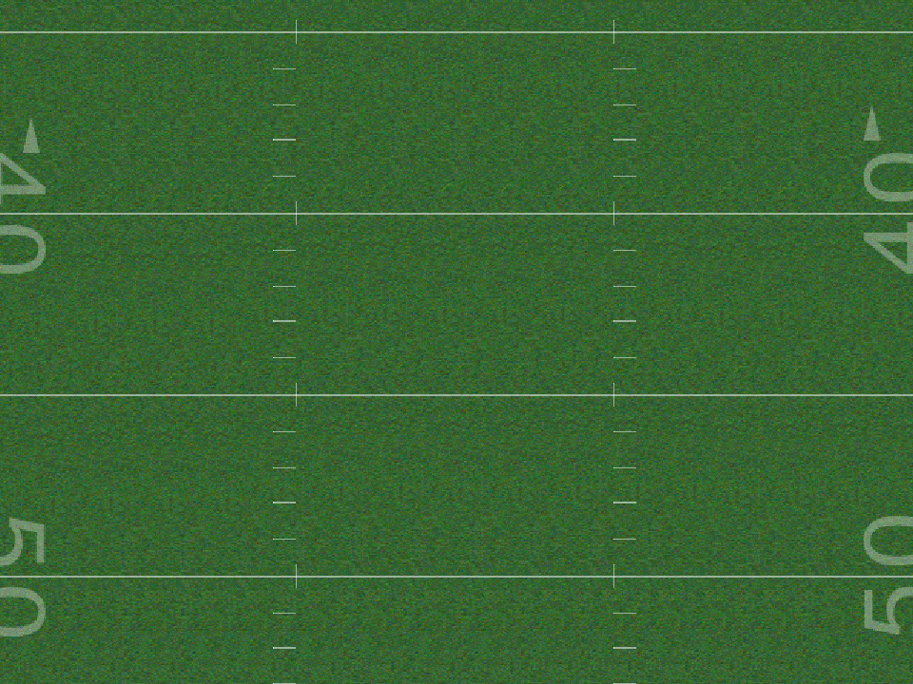
KOR – Return Right
Pos | Man | Technique
LT | #8 | Drop and gain inside leverage on #8. Keep sinking & wall play side. – Don’t let him cross face.
LG | #7 | Drop to gain inside leverage on #7. Keep sinking & wall O.S. – Don’t let him cross face.
C | #6 | Drop to gain inside leverage on #6. Keep sinking & wall O.S. – Don’t let him cross face.
RG | #5 | Open to Inside & Sprint. Keep Playside Leverage on #5. Man can’t cross face into SL/Boundary. If face crossed wash to boundary
RT | DT w/ RM - #4 | Open to Inside & Sprint. Keep Playside Leverage on #2. Man can’t cross face into SL/Boundary. If face crossed wash to boundary
LE | DT w/ LM - #3 | Sprint in straight line to opposite boundary. Find work and block MDM
RE | #2 | Work I.S. – Out of #2. Keep him walled to S.L. after fit. Do not allow #2 to cross face.
LM | DT w/ LM - #3 | Sprint across field & maintain I.S. Leverage on # 3. Make contact between 25-20 YL. Do not allow #3 to cross face & get back I.S. Kickout with LE.
RM | DT w/ RT - #4 | Work forward to meet RT & Seal DT on #4. Look to DT on 30 YL. Fit head up on man & Drive #4 Inside. Do not all #4 to cross face or split DT.
LR | Lead Block - Score | Find Seems on DT’s of #3 & #4. Block M.D.M in alley to his Lev. Return should be run between hash & #’s
RR | Lead Block - Score | Find Seems on DT’s of #3 & #4. Block M.D.M in alley to his Lev. Return should be run between hash & #’s

Slide 10
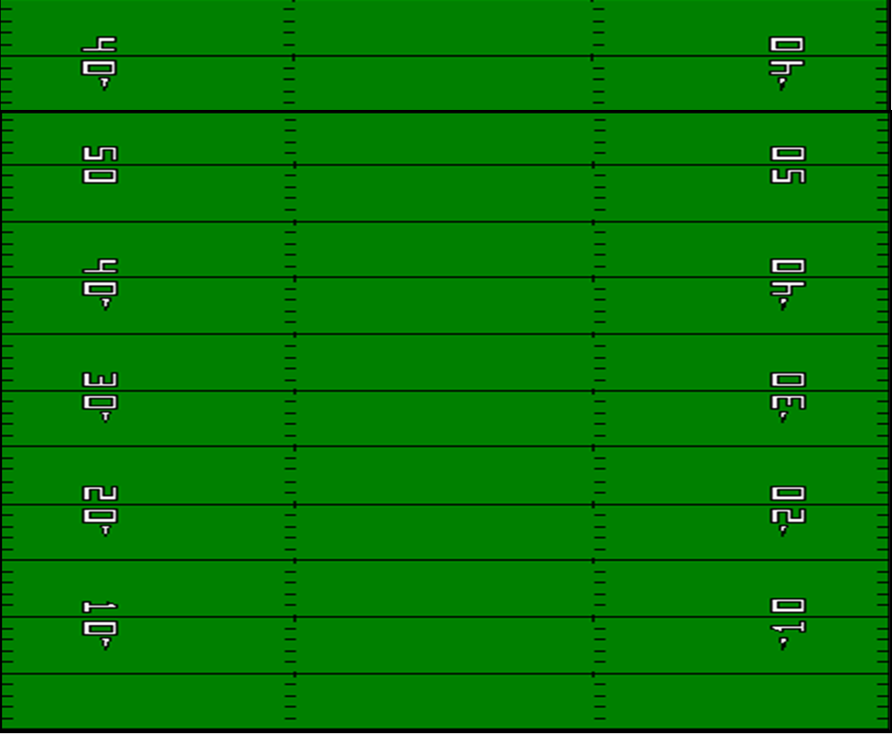
KOR – Onsides - HANDS
10
9
8
7
k
6
5
4
3
2
1
LT
LG
C
RG
RT
RE
LE
LM
RM
RR
LR
LT | LG | C | RG | RT | RE | LE | LM | RM | RR | LR
Align on 48 bottom of #’s Ready for Pop, Onsides, Squib | Align on 48 between hash & #’s Ready for Onsides, Squib, Pop | Align on 48 Adjust to ball. Ready for Onsides, Squib, Pop | Align on 48 on hash Ready for Onsides, Squib | Align on 48 between hash & #’s Ready for Onsides, Squib, Pop | Align on 48 on sideline. Butt to Sideline Ready for Onsides | Align on 40 inside hash Ready for Onsides, Squib, Pop | Align on 40 between hash & #’s in gap between RG & RT Ready for Onsides, Squib, Pop | Align on 40 between #’s & SL in gap between RT & RE butt to S,L Ready for Onsides, Squib, Pop | Align on 30 between hash & #’s in gap between LM & RM – Ready for Pop, Squib, Onside | Align on 25 On hash between Ready for Deep Kick Pop, Squib, Onside

Slide 11
Rugby Punt
#WEWILLWIN
#GAMECHANGERS
LOGO

Slide 12
Alignment
Center – On the Ball ready to snap, eyes on the punter.
Upbacks – Foot to Foot with Center & Guard. Then shift back to outside arm touching guard’s butt. Helmet in the center of “A Gap”. In three point stance.
Guards – I/Side foot to foot with Upbacks. Hands on Thigh boards.
Tackles – I/Side foot at 3 ft from near foot of the guard. Toes on same line of the guard’s toes. Hands on Thigh boards.
Ends – I/Side foot at 3 ft from near foot of the tackle. Toes on the same line of the tackles toes.
Personal Protector – At 7 yards from LOS. RT footed punter – inside foot splitting crotch of RT Upback. LT footed punter – inside foot splitting center of LT Upback. Hands on thigh boards.
Punter – Toes at 14.5 yards. Feet Squared – knees bent – Eyes on Deep Snapper for ball.

Slide 13
Blocking Techniques*
Center – After he snaps the ball yell “GO,GO,GO”, cover and find the ball.
Guards, Tackles & Upbacks – Keep inside foot planted, step with outside foot and punch man through your outside gap & release to landmarks. Ends vs. 2 Men in gap, back pedal/sink to block edge.
4, 5, 6 – Chip inside man and cover. Gunner role. Outsides on the line and inside off the line.
Punter – Call out direction of punt: Left – Middle – Right. After the kick, Safety Left

Slide 14
Rugby Punt – Personnel
5
LT
LG
C
RG
RT
6
4
LUB
RUB
Toes at 7 yds
P
Toes at 14 ½ yds
5 | LT | LG | C-DS | RG | RT | LUB | RUB | 4 | 6 | P
Depth

Slide 15
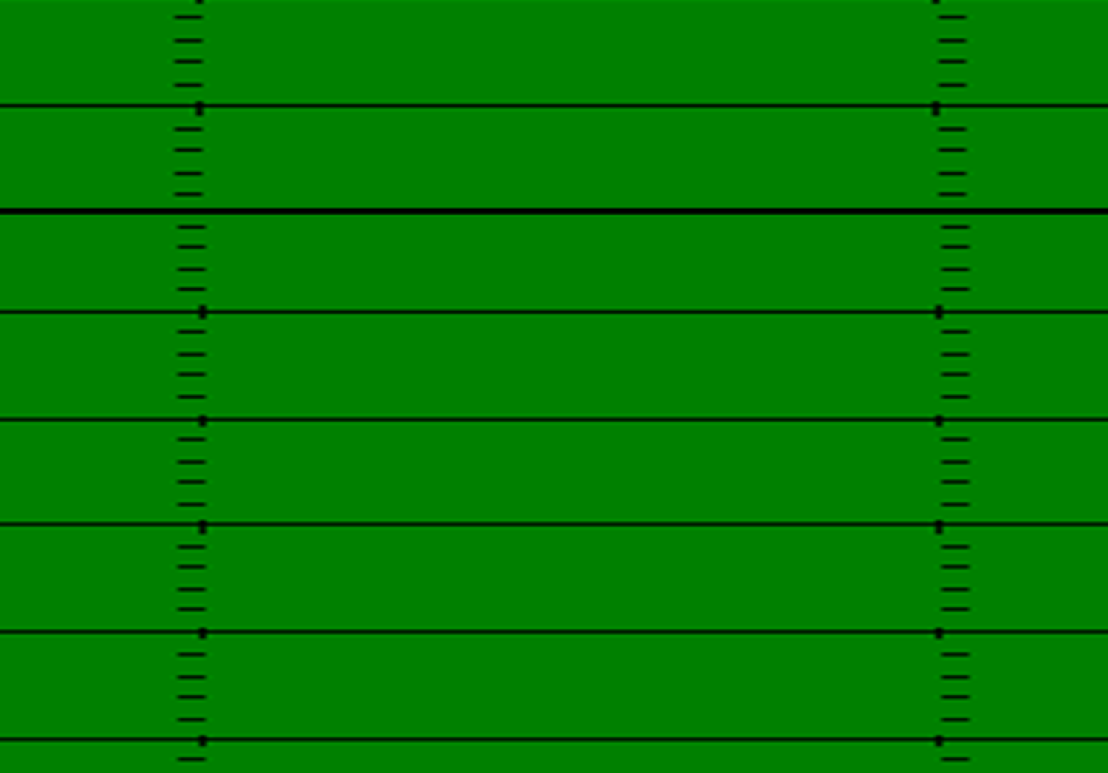
Rugby Punt – Blocking – GAP Protection
C
B
A
A
B
C
5
LT
LG
C
RG
RT
6
4
LUB
RUB
P
5 | LT | LG | C | RG | RT | LUB | RUB | 4 | 6 | P
Punch and release. | C – Gap. Head up to outside. Inside Foot Planted – Punch outside gap | B – Gap. Head up to outside. Inside Foot Planted – Punch outside gap | LT A Gap w/ 2 in Gap. If 2 defenders in Gap - Take 1st threat inside. 1 in Gap release. | B – Gap. Head up to outside. Inside Foot Planted – Punch outside gap | C – Gap. Head up to outside. Inside Foot Planted – Punch outside gap | LT A Gap. If 2 defenders in Gap - Take 2nd threat. Inside Foot Planted – Punch outside gap | RT A Gap. If 2 defenders in Gap - Take 1st threat inside. Inside Foot Planted – Punch outside gap | Punch and release | Punch and release | Punt & Call out direction of kick

Slide 16
Rugby Punt – Blocking – 2 in a Gap
2
1
1
2
LG
C
RG
LUB
RUB
C | LUB | RUB
Left A Gap. If 2 defenders in Gap take # 1. 1 in Gap Release to Coverage | Left A Gap. If 2 in Gap take # 2. If 1 in A Gap take # 1. | RT A Gap. If 2 defenders in Gap - Take 1st threat inside.

Slide 17
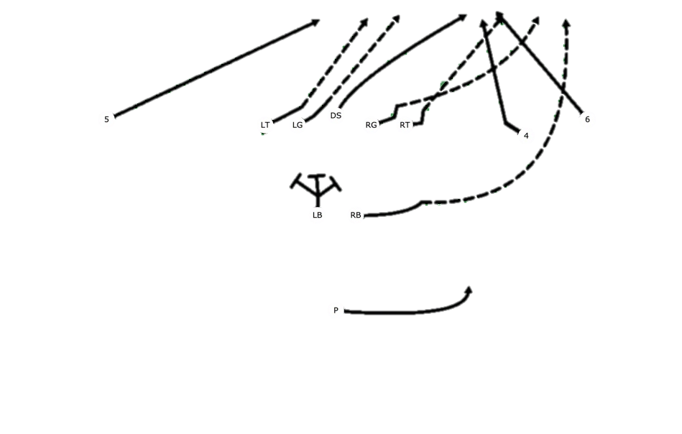
Rugby Punt – Coverage Land Marks
LE | LT | LG | C - DS | RG | RT | RE | LUB | RUB | PP | P
Release to #’s. Squeeze to Contain with shoulders square | Release between #’s & hash. Squeeze to Contain with shoulders square | Release to upright/hash. Squeeze to Contain with shoulders square | Gunner to Ball – Head Up to returner | Release to upright/hash. Squeeze to Contain with shoulders square | Release between #’s & hash. Squeeze to Contain with shoulders square | Release to #’s. Squeeze to Contain with shoulders square | Gunner to Ball – Left Shoulder of Returner | Gunner to Ball –Right Shoulder of Returner | Safety Right | Safety Left

Slide 18
Spread Punt
#WEWILLWIN
#GAMECHANGERS
LOGO

Slide 19
Spread Punt – Alignment
LT
4
6
5
3
2
Q
5 | 3 | LT | LG | C | RG | RT | QB | 2 | 4 | 6
Deuce Alignment on numbers – ***OFF LOS TO MAKE TE ELLIGIBLE | Deuce Alignment – OFF LOS TO MAKE TE ELLIGIBLE | 2 FT split from LG | 2 FT Split from center | On Ball – Eyes to punter | 2 ft Split from center | 2 FT split from RG | Align at 7 YDS – On punt signal shift to 10 yards. | Align even with QB. At snap step for pro. | Deuce Alignment 1/2 between X & RT – ***ON LOS TO MAKE TE ELLIGIBLE | Deuce Alignment on numbers

Slide 20
Spread Punt – Protection
TE
G
C
G
T
$
Q
LT | LG | C | RG | RT | $
Block Left Edge | Block Left to B Gap | Block Left to A Gap | Block Left to A Gap | Block Left to B Gap | Step up and take RT Edge

Slide 21
Spread Punt – Pursuit
R
4
6
5
3
Safety Left
Safety Right
2
Q
5 | 3 | LT | LG | C | RG | RT | QB | 2 | 4 | 6
Pursuit to Returner – Outside Contain – Don’t let returner cross face | Pursuit to near number of returner | Protection to Pursuit of Ball | Protection to Pursuit of Ball | Protection to Pursuit of Ball | Protection to Pursuit of Ball | Protection to Pursuit of Ball | PUNT TO RIGHT – AT NUMBERS Call out direction of punt. Safety left. | Safety Right | Head up to Returner - | Pursuit to near number of returner - Outside Contain

Slide 22
Spread Punt – Downing the ball – No touchbacks/Fair Catch
R
TE
4
6
5
3
Safety Left
Safety Right
2
Q
5 | 3 | TE | LG | C | RG | RT | QB | 2 | 4 | 6
Squeeze Angle to Touch back – Fair catch – Near side number of returner on fair catch | Down the ball – get heels on 1 yard line. Fair Catch Work behind the returner at 5 yards deep | Protection to Pursuit of Ball | Protection to Pursuit of Ball | Protection to Pursuit of Ball | Protection to Pursuit of Ball | Protection to Pursuit of Ball | PUNT TO RIGHT – AT NUMBERS Call out direction of punt. Safety left. | Safety Right | Squeeze Angle to Touch back – Fair catch – Near side number of returner on fair catch | Down the ball – get heels on 1 yard line. Fair Catch Work behind the returner at 5 yards deep

Slide 23
PAT/FG
#WEWILLWIN
#GAMECHANGERS
LOGO

Slide 24
PAT/FG
3
T
G
C
G
T
4
10
5
6
10
X
H
K
5 | 3 | LT | LG | C | RG | RT | 4 | 6 | H | K
45 Degree, arms length from end. Ready, shift down, step w/ inside FT behind near FT of End. | 6 in split, toe-heel stager w/ inside FT back, on Ready, shift down, step w/ inside FT behind near FT of Tackle. | 6 in split, toe-heel stager w/ inside FT back, on Ready, shift down, step w/ inside FT behind near FT of Guard. | 6 in split, toe-heel stager w/ inside FT back, on Ready, shift down, step w/ inside FT behind near FT of Center. | Over the ball ready to snap, eyes on holder. After he says ready, wait for a count, then snap. | 6 in split, toe-heel stager w/ inside FT back, on Ready, shift down, step w/ inside FT behind near FT of Center. | 6 in split, toe-heel stager w/ inside FT back, on Ready, shift down, step w/ inside FT behind near FT of Guard. | 6 in split, toe-heel stager w/ inside FT back, on Ready, shift down, step w/ inside FT behind near FT of Tackle. | 45 Degree, arms length from end. Ready, shift down, step w/ inside FT behind near FT of End. | When kicker gives you the sign he is ready, yell “READY”, get a good hold. | MAKE IT !!

Slide 25
Fire
25
CTHS RANGERS
3
T
G
C
G
T
4
5
6
H
K
5 | 3 | LT | LG | C | RG | RT | 4 | 6 | H | K
Back of end zone to play clock | Block backside |  |  |  |  |  | Back right corner of the end zone | Right Flat 1 yard in the end zone. | FIRE, FIRE, FIRE ! Get away from rush ASAP, Throw to open man or run. | Work to Edge- Eyes inside for 1st threat to sack Holder.

Slide 26
Kickoff
#WEWILLWIN
#GAMECHANGERS
LOGO

Slide 27
KICKOFF– HUDDLE PROCEDURES
Coach
K
1
2
3
4
5
Huddle on 35
Face Direction of Kick
6
7
8
9
10
LR
RR

Slide 28
KICKOFF– HUDDLE PROCEDURES
X
K
1
2
3
4
5
6
7
8
9
10
LR

Slide 29
KICKOFF – Alignment & Field Zones
1 | 2 | 3 | 4 | 5 | 6 | 7 | 8 | 9 | 10 | K
5 YDS from LOS – Split #’s & Sideline | 5 YDS from LOS – Top of #’s | 5 YDS from LOS – Split #’s & Hash | 5 YDS from LOS – Outside of Hash | 5 YDS from LOS – Goal Post | 5 YDS from LOS – Center of FG | 5 YDS from LOS – RT Upright | 5 YDS from LOS – Outside of Hash | 5 YDS from LOS – Split #’s & Hash | 5 YDS from LOS – on the #’s | LT HASH – Kick alignment
War
Contact
Run & Read
X
1
2
3
4
5
6
7
8
9
10
K

Slide 30
KICKOFF – Landmarks & Pursuit
1 | 2 | 3 | 4 | 5 | 6 | 7 | 8 | 9 | 10 | K
Fold & Fit | Bottom of #’s | Top of #’s | Split #’s & Hash | LT Hash | LT Upright | Goal Post | RT Upright | RT Hash | Fold & Fit | Kick Deep Left!!!! Safety
X
1
2
3
4
5
6
7
8
9
10
K
Safety

Slide 31
Onside Kick
#WEWILLWIN
#GAMECHANGERS
LOGO

Slide 32
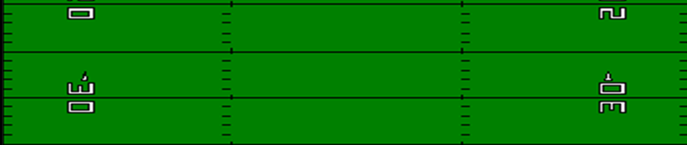
Onsides Kick
ALIGNMENT:
#1-#4- STACK TO LEFT OF BALL
#4 SETS STACK ALLIGNMENT HEELS ON 35 YD LINE
#5 GOAL POST
#6 RIGHT UPRIGHT
#7 ON HASH
#8 BETWEEN # & HASH
#9 MIDDLE OF #S
#10- 2 YDS FROM SIDELINE
ASSIGNMENTS
#1- #4-STACK AND MIRROR BALL INSIDE OUT AS SAFETIES
#5-#9-HOT TO BALL. EXPECT TO GET BALL
#10-KEEP BALL IN BOUNDS
X
1
2
K
3
10
4
5
9
6
7
8

