Slide 1
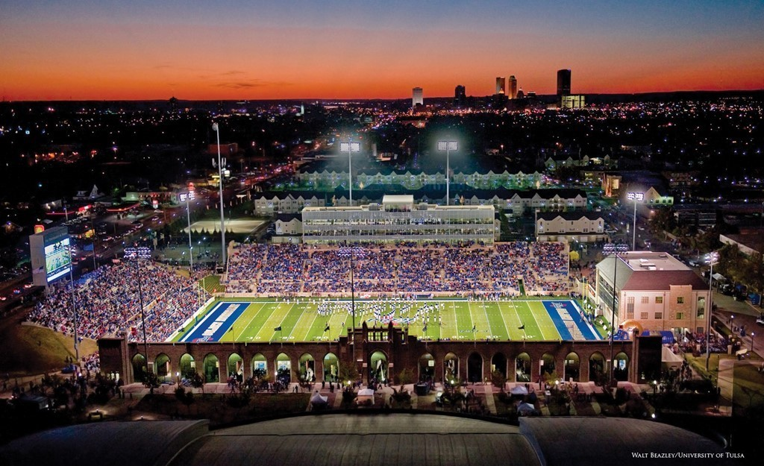




UAPB
FOOTBALL
SCOUTING REPORT
vs
Chapman Stadium
TV: ESPN+
Radio: BIG COUNTRY 99.5 FM KXBL RADIO
Aug 31 (Thursday)
7 p.m. (CT)
“PRACTICE IS EVERYTHING”

Slide 2





UAPB
FOOTBALL
THE BALL
12% RULE
Turnovers:
Sacks:
Penalties:
Drop balls:
“PRACTICE IS EVERYTHING”

Slide 3

UAPB
FOOTBALL
Weekly Schedule
Sunday (Review and Plan)
Monday (Review and Presentations)
Tuesday (Competition Tuesday)
Wednesday (Ball Security Wed)
Thursday (Sweep the Corners)
Friday (Lock In)
“You Will Play Like you Practice!”
“PRACTICE IS EVERYTHING”

Slide 4

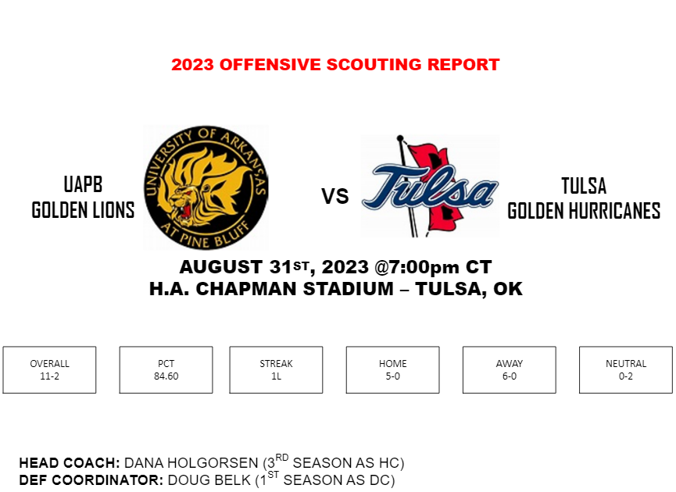
UAPB
FOOTBALL
“PRACTICE IS EVERYTHING”

Slide 5
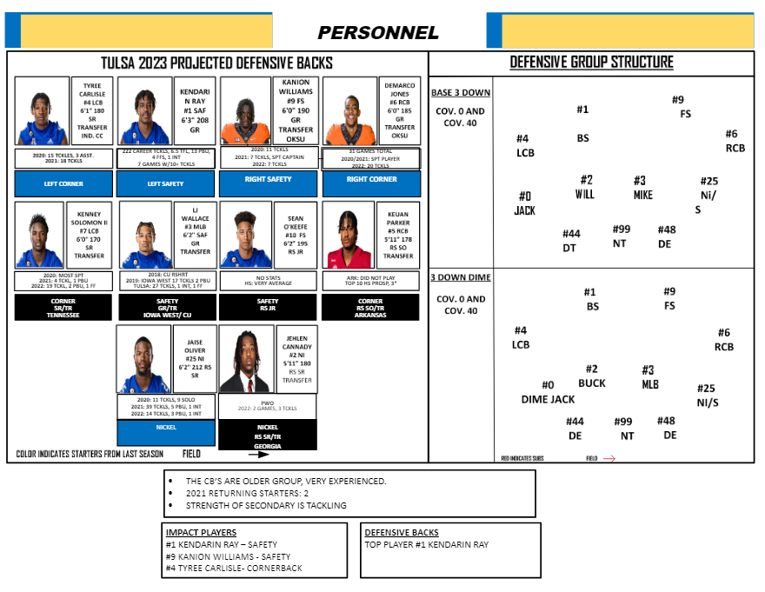
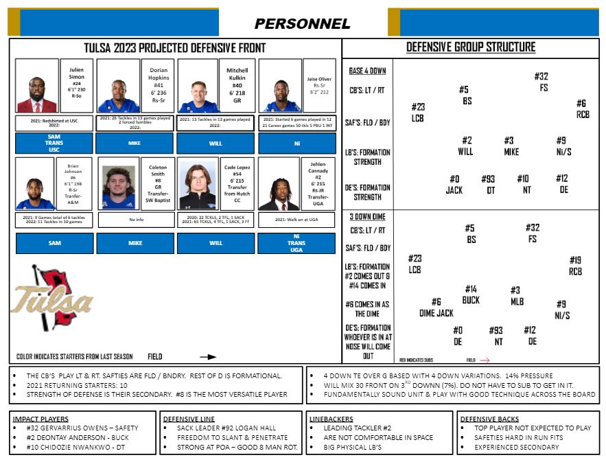

Slide 6
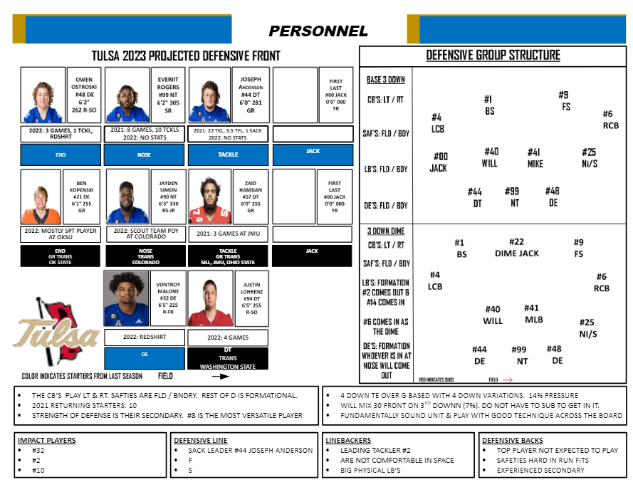

Slide 7
BUCKNELL
THE BALL
SAINTS
FOOTBALL
UAPB
FOOTBALL
COVERAGE REPORT
FRONT
BLITZ
STUNTS
“PRACTICE IS EVERYTHING”

Slide 8
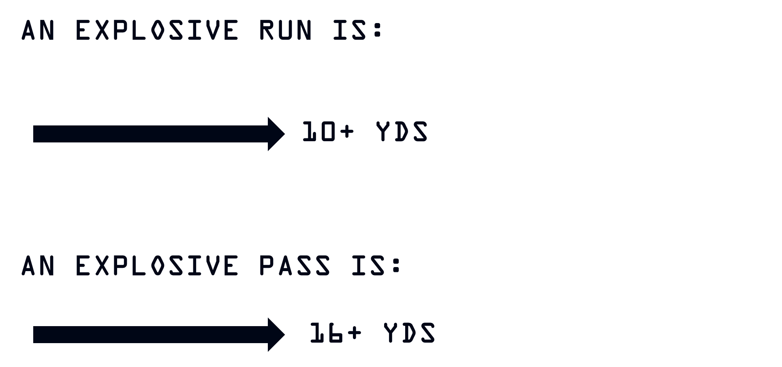
BUCKNELL
EXPLOSIVE PLAYS
SAINTS
EXPLOSIVES
UAPB
FOOTBALL
ASCENDER
FOOTBALL
CREATING EXPLOSIVES
“THIS IS WHO WE ARE”
(9)

Slide 9

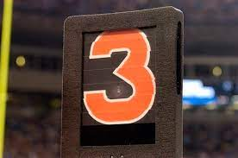
UAPB
FOOTBALL
BUCKNELL
OFFENSIVE SCOUTING REPORT
ASCENDERS
3RD DOWN
3RD DOWN
“CONVERT”
(40%)

Slide 10
UAPB
FOOTBALL
BUCKNELL
OFFENSIVE SCOUTING REPORT
ASCENDERS
3RD DOWN
3RD DOWN
“CONVERT”
(40%)

Slide 12
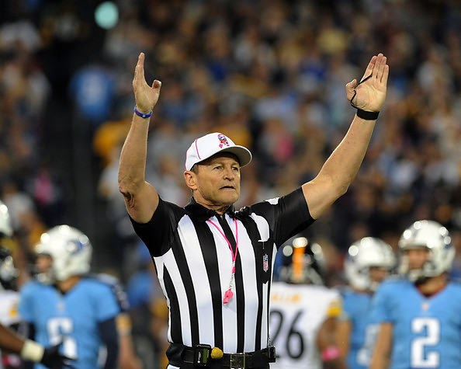
UAPB
FOOTBALL
ASCENDER
REDZONE
100%
“PRACTICE IS EVERYTHING”

Slide 13
UAPB
FOOTBALL
ASCENDER
REDZONE

Slide 14
UAPB
FOOTBALL
GAME PLAN
“PRACTICE IS EVERYTHING”

Slide 15
UAPB
FOOTBALL
FRONT
BLITZ
RUN GAME
PROTECTION
“PRACTICE IS EVERYTHING”

Slide 17
SAINTS
FOOTBALL
UAPB
FOOTBALL
BUCKNELL
OFFENSIVE SCOUTING REPORT
RUN GAME
“PRACTICE IS EVERYTHING”

Slide 19
SAINTS
FOOTBALL
UAPB
FOOTBALL
BUCKNELL
OFFENSIVE SCOUTING REPORT
Protections
“PRACTICE IS EVERYTHING”

Slide 20
50/51
51 Example
ID
W
M
B
E
N
T
E
C
B
A
Q
T
Pass Protection Rules (Half slide half man)
Center ID first LB away from the call side. (5 man box then the mike is the mike)

Slide 21
50/51
51 Example
M
B
ID
W
E
N
T
E
“Out Call”
C
B
A
Q
T
Pass Protection Rules (Half slide half man)
Center ID first LB away from the call side. (5 man box then the mike is the mike)
5 Man Box “Push” Call to Re-ID, T has #1 to #2

Slide 22
60/61
61 Example
ID
W
M
B
E
N
T
E
C
B
A
Q
T
Pass Protection Rules (Half slide half man)
Center ID first LB away from the call side. (5 man box then the mike is the mike)

Slide 23
60/61
61 Example
M
B
ID
W
E
N
T
E
“Out Call”
C
B
A
Q
T
Pass Protection Rules (Half slide half man)
Center ID first LB away from the call side. (5 man box then the mike is the mike)
5 Man Box “Push” Call to Re-ID, T has #1 to #2

Slide 26
SAINTS
FOOTBALL
UAPB
FOOTBALL
BUCKNELL
OFFENSIVE SCOUTING REPORT
ASCENDER
FOOTBALL
DECEPTIVES
“PRACTICE IS EVERYTHING”

Slide 27
SAINTS
FOOTBALL
UAPB
FOOTBALL
BUCKNELL
OFFENSIVE SCOUTING REPORT
ASCENDER
FOOTBALL
NEW
PASS PLAYS
“PRACTICE IS EVERYTHING”

Slide 28
BUCKNELL
OFFENSIVE SCOUTING REPORT
UAPB
FOOTBALL
PASS GAME
“PRACTICE IS EVERYTHING”

Slide 43
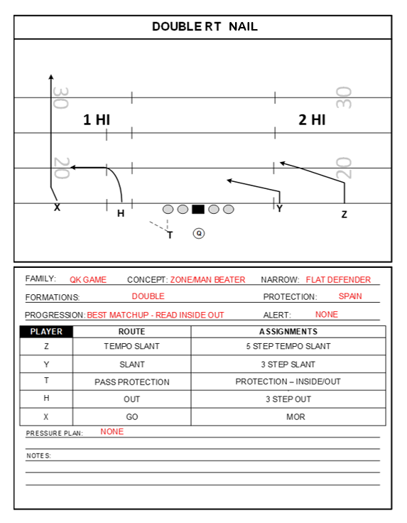

Slide 44
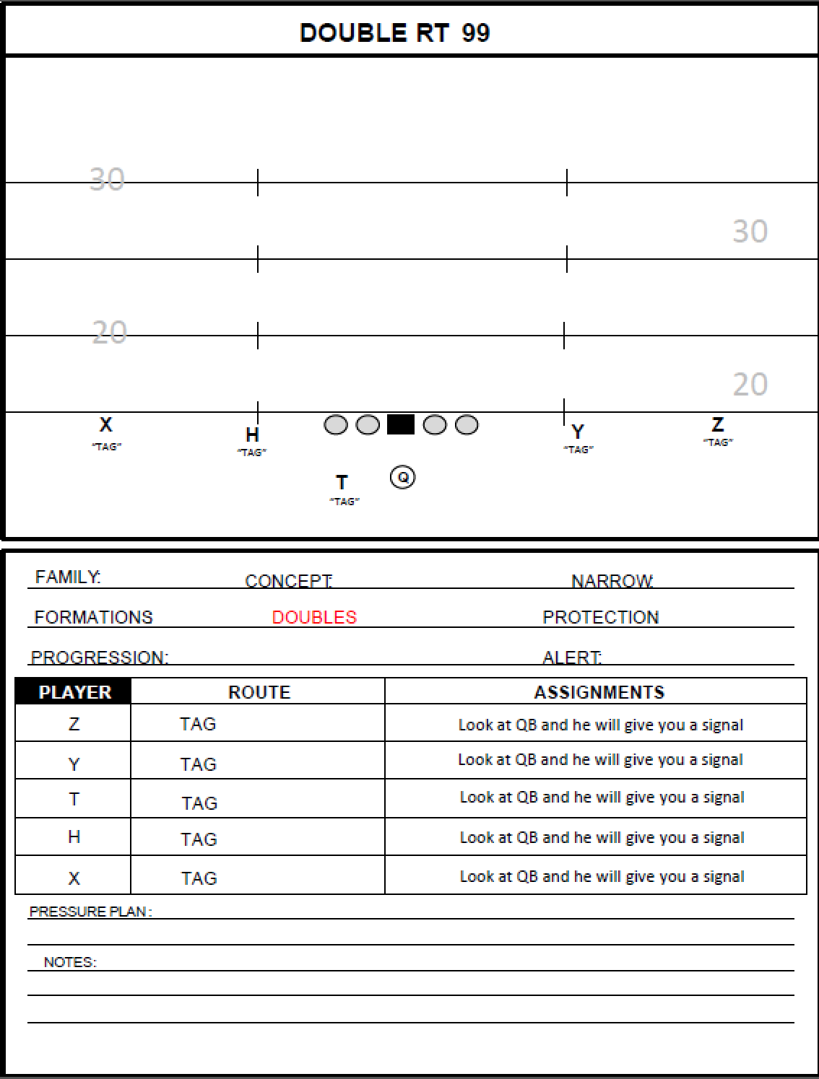

Slide 56
SAINTS
FOOTBALL
BUCKNELL
OFFENSIVE SCOUTING REPORT
ASCENDER
FOOTBALL
SCREENS
“PRACTICE IS EVERYTHING”

Slide 63
SAINTS
FOOTBALL
UAPB
FOOTBALL
BUCKNELL
OFFENSIVE SCOUTING REPORT
ASCENDER
FOOTBALL
KEYS TO
VICTORY
“PRACTICE IS EVERYTHING”

Slide 64

BUCKNELL
KEYS TO VICTORY
SAINTS
KEYS TO VICTORY
UAPB
FOOTBALL
KEYS TO VICTORY
“KEYS TO VICTORY”
1) THE BALL
2) NO UNFORCED ERRORS
3) PLAY THE NEXT PLAY
4) COMMUNICATION
5) PLAY HARD AND AGGRESSIVE
6) UMAC FOOTBALL GAME
7) EXPLOSIVE PLAYS
8) ESTABLISH RHYTHM
9) WIN THE SITUATIONS
10) DOMINATE 60 MINUTES
11) VENICE WILL PLAY ITS BEST FOOTBALL
12) DO YOUR PART, PLAY WITHIN YOUR SELF
“PRACTICE IS EVERYTHING”

Slide 65
QB/WR STUDY
UAPB
FOOTBALL
TOP COVERAGE VS 2X2: _________________________________________________________
TOP COVERAGE VS 3X1: _______________________________________________________
PREDOMINANTLY MAN OR ZONE: _________________________________________________
CORNERS FIELD/BOUNDARY OR SAME SIDE: _____________________
CORNERS PRESS MAN OR SOFT MAN: ______________________
DEPTH OF SOFT CORNERS: ______________________________________________________
“PRACTICE IS EVERYTHING”

Slide 66
QB/WR STUDY
UAPB
FOOTBALL
WHAT PRESS TEGHNIQUE DO THE CORNERS PLAY:
LT/CB
______________________________________________
RT/CB
_______________________________________________
SAFETY DEPTH IN COV 2: ________
SAFETY DEPTH IN COV 4: ______________________
“PRACTICE IS EVERYTHING”

Slide 67
QB/WR STUDY
UAPB
FOOTBALL
SAFETIES ROLL TO THE FIELD OR BNDRY VS 2X2 ____________
SAFETIES ROLL TO THE FIELD OR BNDRY VS 3X1 _____
WHO IS THEIR NICKEL: ______
TOP 3RD DOWN COVERAGE: _____________________________________________________
WHAT UNIQUE COVERAGES: _____________________
HIGH/LOW PRESSURE ON BASE DOWNS ___________________________________________
HIGH/LOW PRESSURE ON THIRD DOWN __________________________________________
“PRACTICE IS EVERYTHING”

