Slide 1

UAPB
QB GAME BOOK
SCOUTING REPORT
“SEIZE THE OPPORUNITIES AND MAKE IT HAPPEN!”
“PRACTICE IS EVERYTHING”

Slide 2

UAPB
QB GAME BOOK
BIG THREE
THE BALL
PHYSICAL
WIN THE SITUATION
“PRACTICE IS EVERYTHING”

Slide 3
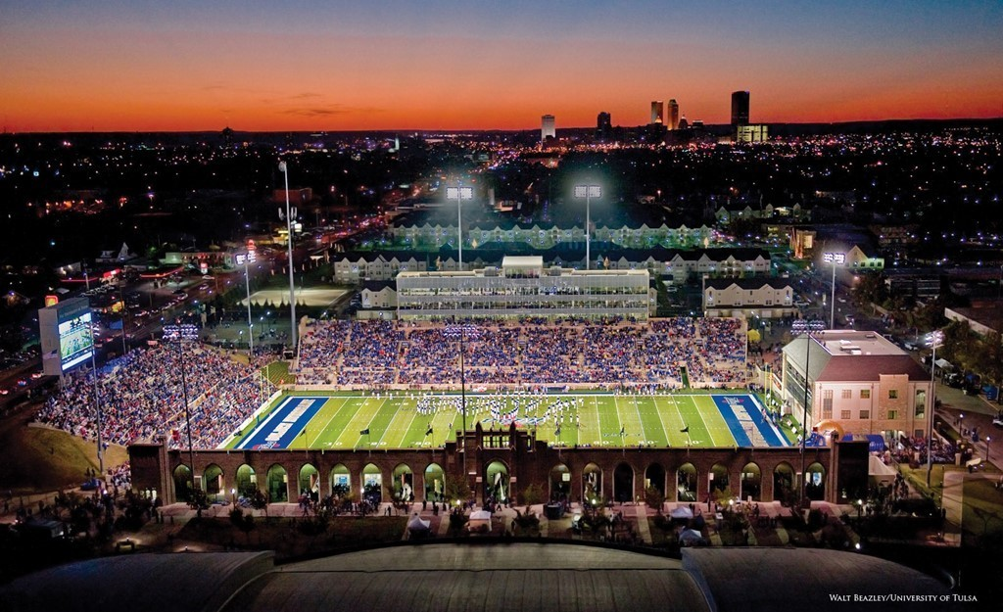

UAPB
QB GAME BOOK
SCOUTING REPORT
Chapman Stadium
TV: ESPN+
Radio: BIG COUNTRY 99.5 FM KXBL RADIO
Aug 31 (Thursday)
7 p.m. (CT)

Slide 4
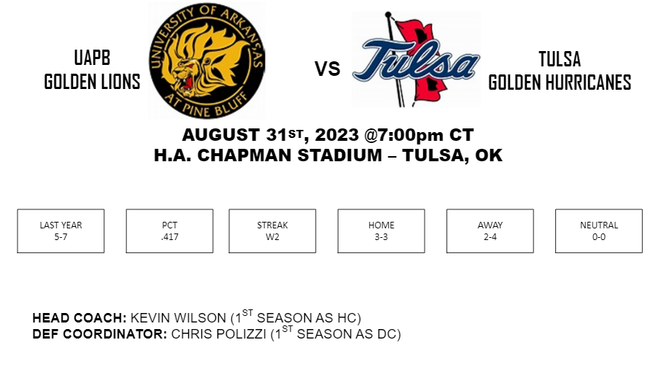
UAPB
QB GAME BOOK

Slide 5
UAPB
QB GAME BOOK
DEFENSIVE SUMMARY
Coach Evan
Chapman Stadium
TV: ESPN+
Radio: BIG COUNTRY 99.5 FM KXBL RADIO
Aug 31 (Thursday)
7 p.m. (CT)
“PRACTICE IS EVERYTHING”

Slide 6
UAPB
QB GAME BOOK
FRONTS: Odd (229x), LION (30x), 30 (11x; end of game/half), N42 Tite (SYD)
BLITZES: JAM (15%), BDY CAT (13%), BDY JET (12%), BDY SCRAPE SW (11%), BDY SONIC (8%), CROSS BULLETS (8%), SINGLE POP (17%)
BRING PRESSURE = 60%
NO PRESSURE = 40%
COVERAGES:

Slide 7
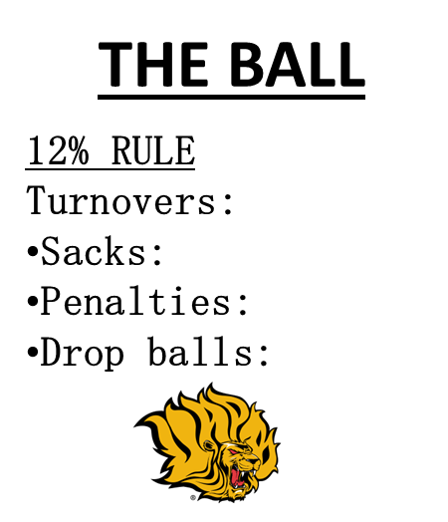
UAPB
QB GAME BOOK

Slide 8
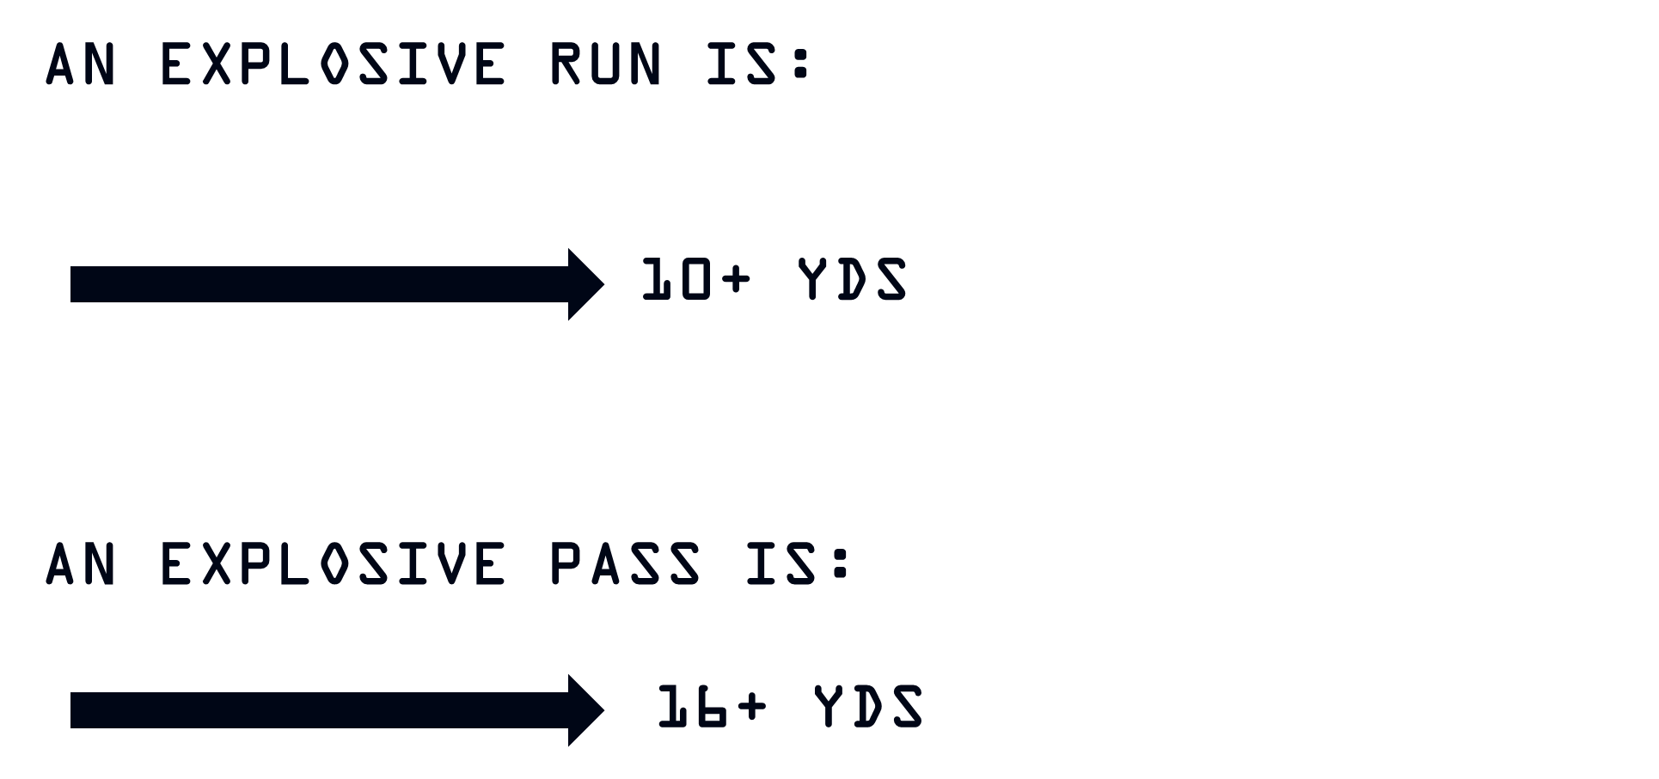
UAPB
QB GAME BOOK
CREATING EXPLOSIVES
“THIS IS WHO WE ARE”
(9)

Slide 9
UAPB
QB GAME BOOK
DEPTH CHART
Position Coaches

Slide 10
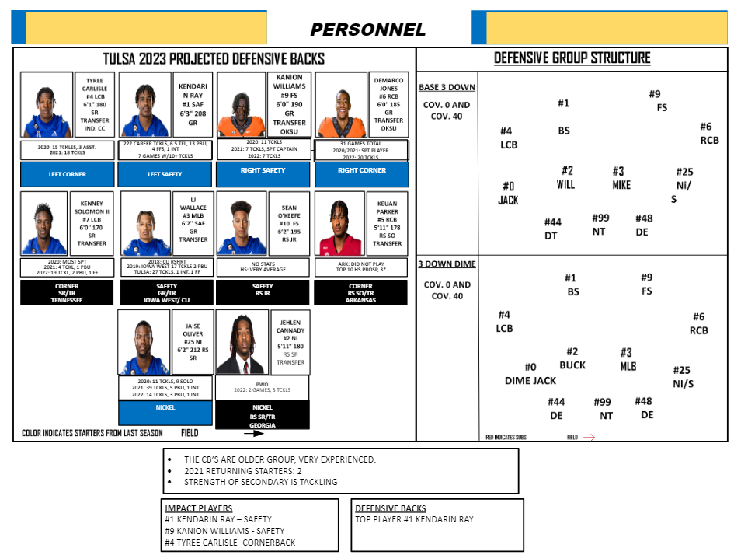
UAPB
QB GAME BOOK
DEPTH CHART
Chapman Stadium
TV: ESPN+
Radio: BIG COUNTRY 99.5 FM KXBL RADIO
Aug 31 (Thursday)
7 p.m. (CT)

Slide 11
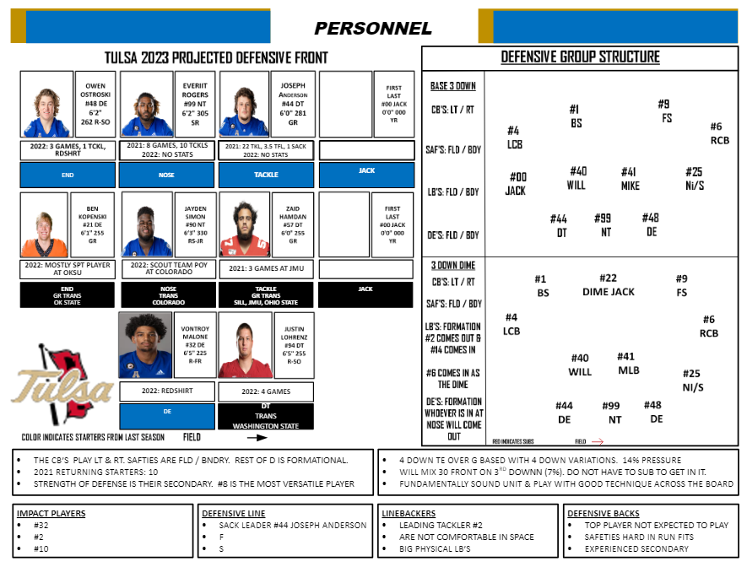
UAPB
QB GAME BOOK
DEPTH CHART
Chapman Stadium
TV: ESPN+
Radio: BIG COUNTRY 99.5 FM KXBL RADIO
Aug 31 (Thursday)
7 p.m. (CT)

Slide 12
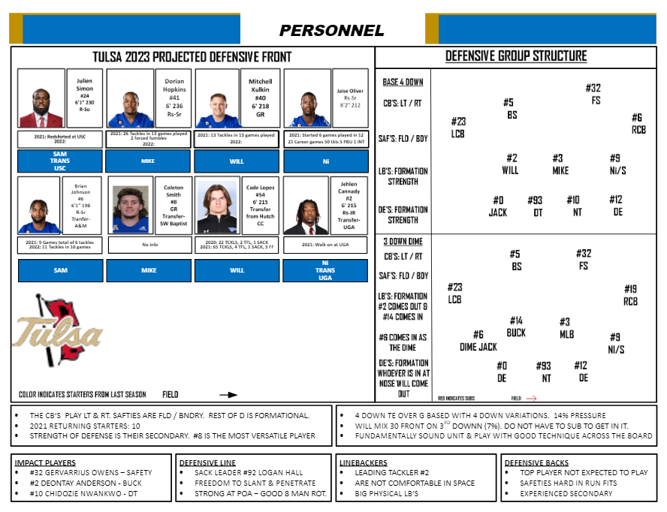
UAPB
QB GAME BOOK
DEPTH CHART
Chapman Stadium
TV: ESPN+
Radio: BIG COUNTRY 99.5 FM KXBL RADIO
Aug 31 (Thursday)
7 p.m. (CT)

Slide 13
UAPB
QB GAME BOOK
COVERAGE REPORT
Coach Nord

Slide 14
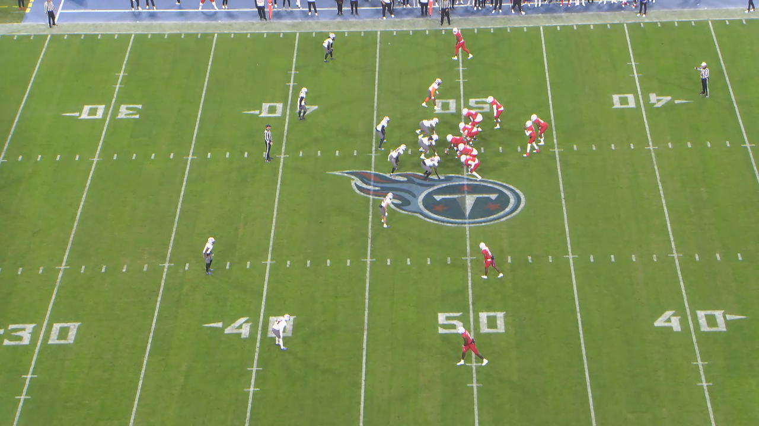
UAPB
QB GAME BOOK
QUEEN
COVER 4
Top coverage

Slide 15
UAPB
QB GAME BOOK
DBLS
COVER 4
70% vs DBLS

Slide 16
UAPB
QB GAME BOOK
FRONTS
Coach Wallace
“PRACTICE IS EVERYTHING”

Slide 17
UAPB
QB GAME BOOK

Slide 18
UAPB
QB GAME BOOK
BLITZ AND STUNTS
REPORT
Coach Wallace
Chapman Stadium
TV: ESPN+
Radio: BIG COUNTRY 99.5 FM KXBL RADIO
Aug 31 (Thursday)
7 p.m. (CT)
“PRACTICE IS EVERYTHING”

Slide 19
UAPB
QB GAME BOOK

Slide 20
UAPB
QB GAME BOOK

Slide 21
UAPB
QB GAME BOOK

Slide 22
UAPB
QB GAME BOOK

Slide 23
UAPB
QB GAME BOOK

Slide 24
UAPB
QB GAME BOOK

Slide 25
UAPB
QB GAME BOOK

Slide 26
UAPB
QB GAME BOOK

Slide 27
UAPB
QB GAME BOOK

Slide 28
UAPB
QB GAME BOOK

Slide 29
UAPB
QB GAME BOOK

Slide 30
UAPB
QB GAME BOOK

Slide 31
UAPB
QB GAME BOOK

Slide 32
UAPB
QB GAME BOOK

Slide 33
UAPB
QB GAME BOOK

Slide 34
UAPB
QB GAME BOOK

Slide 35
UAPB
QB GAME BOOK

Slide 36
UAPB
QB GAME BOOK

Slide 37
UAPB
QB GAME BOOK

Slide 38
UAPB
QB GAME BOOK
GAMEPLAN
Coach ACOSTA
Chapman Stadium
TV: ESPN+
Radio: BIG COUNTRY 99.5 FM KXBL RADIO
Aug 31 (Thursday)
7 p.m. (CT)

Slide 39
UAPB
QB GAME BOOK

Slide 40
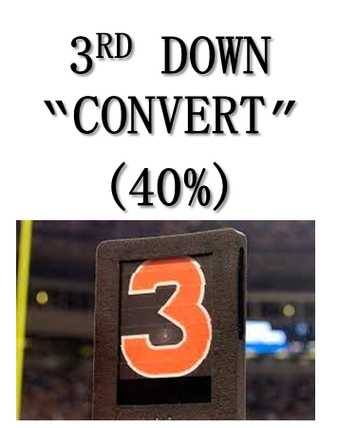
UAPB
QB GAME BOOK
3rd Down Report
Coach Kramer
Chapman Stadium
TV: ESPN+
Radio: BIG COUNTRY 99.5 FM KXBL RADIO
Aug 31 (Thursday)
7 p.m. (CT)
“PRACTICE IS EVERYTHING”

Slide 41
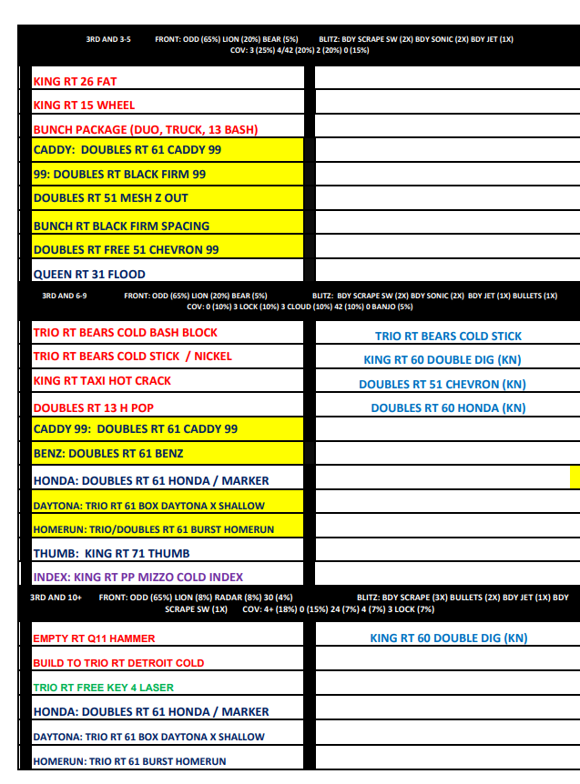
UAPB
QB GAME BOOK

Slide 42
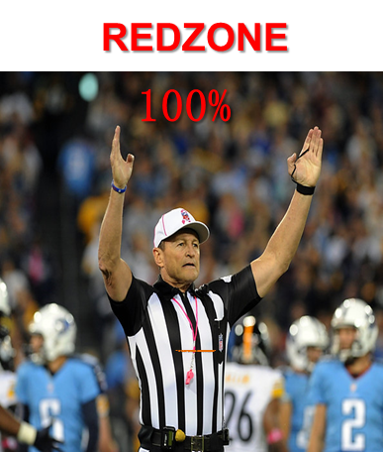
UAPB
QB GAME BOOK
RED ZONE REPORT
Coach Kramer
Chapman Stadium
TV: ESPN+
Radio: BIG COUNTRY 99.5 FM KXBL RADIO
Aug 31 (Thursday)
7 p.m. (CT)
“PRACTICE IS EVERYTHING”

Slide 43
Redzone Reminders
When we cross the 50 yard line, expect to score. Expect Shots, nakeds, screens, pap, runs. Protection is at a premium
Avoid self inflicted negatives (SINS), mental errors, pre-snap procedure penalties, drops and missed throws
QB must avoid Sacks – Throw the ball away. Yardage is precious. Take the FG
Expect more pressure the closer you get to the endzone
WR’s must defeat Man to Man
“PRACTICE IS EVERYTHING”

Slide 44
The Closer we get to the End zone
The smaller the Zones and Windows get, so QB has to be more accurate. Put the ball on WR’s body
Think TD, Check Down – The RB is your friend!
Think Players, not plays
The least defended part of the End zone is the back 2 yards.
“PRACTICE IS EVERYTHING”

Slide 45
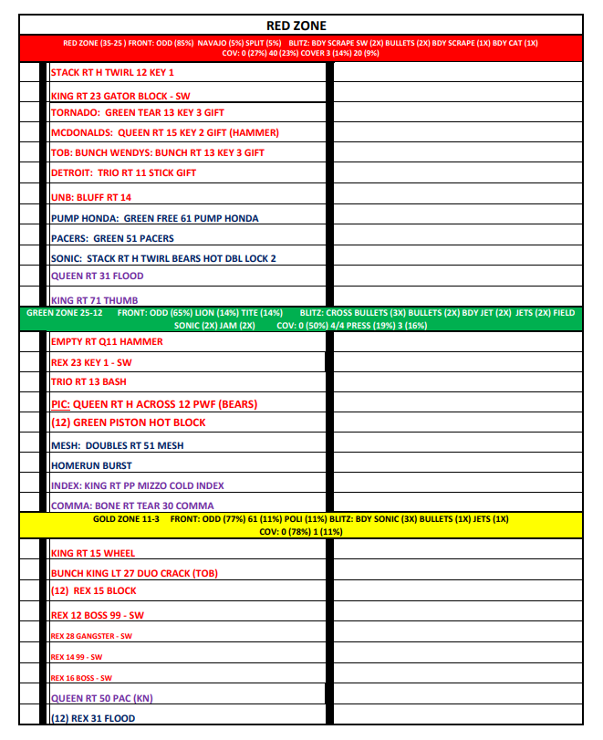
UAPB
QB GAME BOOK

Slide 46
UAPB
QB GAME BOOK
OFF SCHEDULE OFFENSE
Chapman Stadium
TV: ESPN+
Radio: BIG COUNTRY 99.5 FM KXBL RADIO
Aug 31 (Thursday)
7 p.m. (CT)
“PRACTICE IS EVERYTHING”

Slide 47
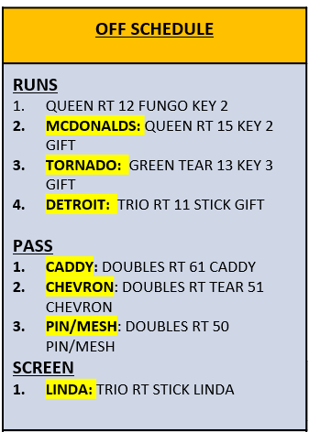
UAPB
QB GAME BOOK

Slide 48
UAPB
QB GAME BOOK
2 MINUTE OFFENSE
Chapman Stadium
TV: ESPN+
Radio: BIG COUNTRY 99.5 FM KXBL RADIO
Aug 31 (Thursday)
7 p.m. (CT)
“PRACTICE IS EVERYTHING”

Slide 49
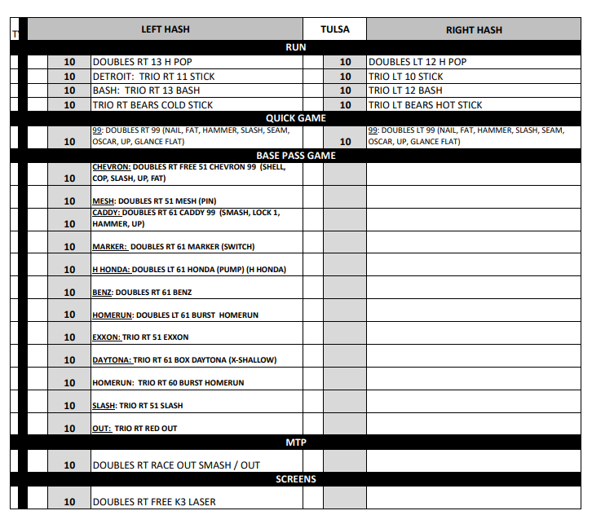
UAPB
QB GAME BOOK

Slide 50
UAPB
QB GAME BOOK
4 MINUTE OFFENSE
Chapman Stadium
TV: ESPN+
Radio: BIG COUNTRY 99.5 FM KXBL RADIO
Aug 31 (Thursday)
7 p.m. (CT)
“PRACTICE IS EVERYTHING”

Slide 51
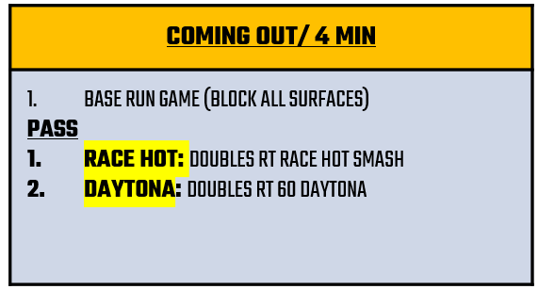
UAPB
QB GAME BOOK

Slide 52
UAPB
QB GAME BOOK
KEYS TO VICTORY
Coach Acosta
Chapman Stadium
TV: ESPN+
Radio: BIG COUNTRY 99.5 FM KXBL RADIO
Aug 31 (Thursday)
7 p.m. (CT)
“PRACTICE IS EVERYTHING”

Slide 53

UAPB
QB GAME BOOK
1) THE BALL
2) NO UNFORCED ERRORS
3) PLAY THE NEXT PLAY
4) COMMUNICATION
5) PLAY HARD AND AGGRESSIVE
6) EXPLOSIVE PLAYS
7) ESTABLISH RHYTHM
8) WIN THE SITUATIONS
9) DOMINATE 60 MINUTES
10) TULSA WILL PLAY ITS BEST FOOTBALL
11) DO YOUR PART, PLAY WITHIN YOUR SELF

Slide 54
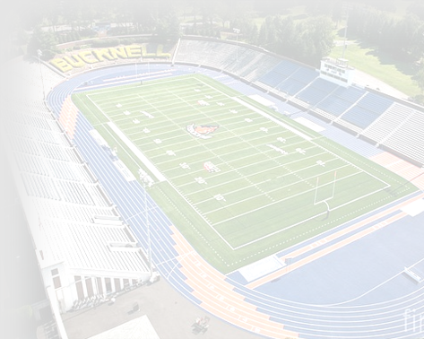
“Winning is the quarterbacks most important job.”
ASCENDER
QB GAME BOOK
UAPB
QB GAME BOOK
SCORE – As the quarterback you are responsible for getting your team in the end zone.
STAY HUNGRY – You never stay the same. Strive to get better everyday.
WORK ETHIC – No secrets, hard work.
THINK FAST, PLAY FAST – Preparation.
STUDY YOUR OFFENSE – What, Why, When.
FUNDAMENTALS AND TECHNIQUES – Deal with the details, must be ingrained in you so you react fundamentally. Be quick, but not in a hurry.
STUDY DEFENSIVE FOOTBALL – No surprises.
REMEMBER – “You are never done.”

