Slide 1


2023
INSTALL 1

Slide 2
“We Don’t Inherit an Attitude, We Create It”

Slide 3

5 Star Character ⭐️⭐️⭐️⭐️⭐️
SMART
DISCIPLINE
COMPETITIVE
HARD WORKING
SELFLESS
STUDENT ATHLETE IS A LIFESTYLE
KEYS TO SUCCESS: BE ON TIME! WORK HARD! PAY ATTENTION! | EVALUATION CRITERIA: DO YOU KNOW WHAT TO DO? ARE YOU DOING THE THINGS YOU ARE COACHED TO DO? ARE YOU THE SAME PLAYER EVERYDAY? | EVERY PLAY MUSTS: DO YOUR JOB FIRST. TRUST THE GUY NEXT TO YOU. COMMUNICATE. FOCUS. FINISH.

Slide 4
2023 PLAYBOOK
PHILOSOPHY

Slide 5
BLUEPRINT FOR SUCCESS
SMART
TOUGH
COMPETITVE
HARDWORKING
SELFLESS
THE PROGRAM IS IMPORTANT
PHILOSOPHY

Slide 6

“OUR TEMPO”
(OUR BEST OFFENSIVE PLAY)
We Will Not Huddle!
  O-Line must get to ball and get set Immediately
  QB will give OL direction the WR’s and RB’s must see the signals
  Once given formation and motion, we must get lined up and ready to receive the play fast as possible

Slide 7
OUR TEMPO
(OUR BEST OFFENSIVE PLAY)
  Position Responsibilities
  QB - Receive signals, communicate and demand tempo
  WR - If you can get set and see the signal from the sideline – Do it
    If you can’t get signal from sideline – Give QB your eyes and “Call Me”
  RB – Align for success with possibility of late motion or movement

Slide 8
12% RULE
TURNOVERS
SACKS
DROP BALLS
FOOLISH PENALTIES
OUR WINNING PERCENTAGE GOES UP TO 92% WHEN WE ARE UNDER 12%
EXAMPLE: 90 OFFENSIVE PLAYS-12% OF 90 IS 11 PLAYS.
WE MUST HAVE NO MORE THAN 11 PLAYS FROM ABOVE.

Slide 9
LINE OF SCRIMMAGE CALLS
DIRECTIONAL CALLS – A CALL AT THE L.O.S. TO GIVE THE DIRECTION OF THE PLAY GIVEN EITHER “RIGHT” OR “LEFT”
SKILL POSITION: GET THE SIGNALS FROM THE SIDELINE
CODE WORDS/# FOR “LEFT” DIRECTION | CODE WORDS/# FOR “RIGHT” DIRECTION
25 / 13 25 / 61 CHEVRON (ONEWORD PLAYS) | 25 / 12 25 / 60 CHEVRON (ONEWORD PLAYS)

Slide 10



BRICK BY BRICK
MENU

Slide 11
INSTALL 1
RUN SCHEME
12/13 (INSIDE ZONE)
14/15 (SPLIT ZONE)
16/17 (MIZZ)
PROTECTIONS
50/51
60/61
30/31 PA BOOT
PASS CONCEPTS
CHEVRON
EXXON
CADDY
DAYTONA
HOMERUN
FORMATIONS
DOUBLES
TRIO
QUEEN
KING
GREEN/BLUE
RUN RELIEF & RPO
KEY 1
KEY 2
KEY 3
GIFT
STORM
SCREENS (40/41)
40/41 (ROSE / LINDA)
MOTION
GHOST
QUICK GAME
FAT
SLASH
NAIL

Slide 12
2023 PLAYBOOK
FORMATIONS

Slide 13
FORMATIONS
BUILDING FORMATIONS:
Y: THE Y WR ALWAYS SETS THE STRENGTH OF THE FORMATION. THE RIGHT (RT) AND LEFT (LT) CALL WILL DIRECT WHERE THIS PLAYER GOES. BASE ALIGNMENT IS ON THE BALL, ALERTS OUTSIDE WR’S IF THEY ARE Z OR X.
Z/X: OUTSIDE WR’S DO NOT SWITCH SIDES (UNLESS YOU PREFER THAT THEY DO). THE
WR’S ALL LEARN Z AND X ROUTES. WR TO THE STRENGTH BECOMES THE Z, THIS WR
ALWAYS HAS THE Y TO HIS SIDE. THE X IS ALWAYS AWAY FROM THE STRENGTH OF THE
FORMATION.
F: INSIDE WR, THIS IS THE WR THAT BUILDS THE FORMATION (2X2, 3X1).
T: ONE BACK FORMATIONS ALWAYS ALIGNS BASED ON THE PLAY

Slide 14
FORMATIONS
10/11/20 PERSONNEL
DOUBLES (RT/LT)
TRIO (RT/LT)
king (RT/LT)
queen (RT/LT)
gReen/ blue

Slide 15
FORMATIONS
BUILDING FORMATIONS
TWO BACK FORMATIONS: DESIGNATED BY COLORS. R OR L IN THE COLOR WILL DESIGNATE THE STRENGTH OF THE FORMATION: GREEN (RIGHT) AND BLUE (LEFT)
2X2 FORMATIONS: TRADITIONALLY DESIGNATED BY D WORDS: DUAL/DART/DOUBLE
3X1 FORMATIONS: TRADITIONALLY DESIGNATED BY T WORDS: TRIO/TREY/TRIPS
SLOT FORMATIONS: FORMATIONS WHERE Z FLIPS TO THE WEAK SIDE CREATING A SLOT LOOK AND F TO STRONG SIDE USE F WORDS: FLEX/FLANK
BIG F FORMATIONS: NEW FORMATION SERIES DESIGNATED BY FACE CARDS: QUEEN, KING

Slide 16
DOUBLE
X
Y
H
Z
T
Q
DOUBLE RT
Z
Y
X
H
T
Q
DOUBLE LT

Slide 17
TRIO
X
Y
H
Z
T
Q
TRIO RT
Z
H
Y
X
T
Q
TRIO LT

Slide 18
KING
X
H
Y
Z
T
Q
KING RT
Z
H
Y
X
T
Q
KING LT

Slide 19
QUEEN
X
H
Y
Z
T
Q
QUEEN RT
Z
H
X
Y
T
Q
QUEEN LT

Slide 20
GREEN/BLUE
X
Y
Z
T
Q
F
GREEN
Z
Y
X
F
Q
T
BLUE

Slide 21
2023 PLAYBOOK
MOTIONS

Slide 22
MOTIONS
BUILDING TWO BACK MOTIONS:
TWO BACK MOTION: WHEN USING TEAR, TRAVEL, FAST, FREE FROM TWO BACK
FORMATIONS (GREEN/BLUE) YOU ARE SENDING A SPECIFIC BACK IN A SPECIFIC
DIRECTION. WHEN INSTALLING THIS OFFENSE OR UNDERSTANDING YOUR
PERSONNEL YOU CAN TEACH A SPECIFIC PLAYER THAT THEY ALWAYS ALIGN IN
THE SPOT THAT IS GOING IN MOTION. OR IF YOU HAVE TWO TRUE BACKS AND
BOTH CAN MOTION THEN YOU TEACH BY JUST THE WORDS. ALL BASED ON
PREFERENCE AND PLAYERS YOU HAVE (EVERY YEAR IS DIFFERENT!)

Slide 23
MOTIONS
BUILDING ONE BACK MOTIONS
ONE BACK MOTIONS: WHEN USING TEAR AND TRAVEL OUT OF ONE BACK FORMATIONS YOU CREATE EMPTY SETS. IN THIS SITUATION THE TEAR AND TRAVEL ARE TAUGHT A BIT DIFFERENT. IN ONE BACK FORMATIONS THE BAK ALIGNS BASED ON THE SPECIFIC PLAY CALL. THE SAME IS DONE WITH ONE BACK MOTION CALLS. IF TEAR CHEVRON IS CALLED THE BACK WILL ALIGN OPPOSITE THE SIDE HE NEEDS TO MOTION TOWARDS WHEN CREATING THE SWING FOR CHEVRON. WHERE AS IN TRAVEL THE BACK WILL ALIGN TO THE SAME SIDE THAT HE WILL MOTION TOWARDS FOR THE PLAY CALL.

Slide 24
2023 PLAYBOOK
TEAR

Slide 25
TEAR
X
Y
Z
GREEN TEAR
Q
F
T
COACHING POINTS:
SNAP COUNT: TWO WORDS, FIRST STARTS MOTION SECOND ALERTS CENTER TO SNAP BALL. T BEGINS MOTION FULL SPEED AND BALL WILL BE SNAPPED AT TACKLE.
MOTION TO FIELD: FIVE HARD STEPS AFTER BALL IS SNAPPED BEFORE TURNING
MOTION TO BOUNDARY: THREE HARDS STEPS AFTER BALL IS SNAPPED BEFORE TURNING.
EXAMPLE PLAY: GREEN TEAR ZORRO ODD COMET

Slide 26
2023 PLAYBOOK
GHOST

Slide 27
GHOST
X
Y
H
Z
DOUBLE RT H GHOST
Q
T
COACHING POINTS:
SNAP COUNT: NORMAL SNAP COUNT AS THE MOTION IS SLOWER. SNAP BALL ONCE BACK IS NEAR YOU IN THE BACKFIELD.
MOTION: MUST GIVE YOURSELF SPACE FROM THE TACKLE TO GET TO FULL SPEED. GIVE APPEARANCE THAT IT IS QUICK MOTION THEN ONE YARD FROM TACKLE CHANGE DIRECTION TO AIM FOR BEHIND THE QUARTERBACK. GET INTO COMET RELATIONSHIP

Slide 28
2023 PLAYBOOK
RUN GAME

Slide 29


RUN GAME
INSIDE ZONE
12/13

Slide 30
RUN GAME
12/13: INSIDE zone
14/15: DIVIDE ZONE
16/17: Mid Zone

Slide 31
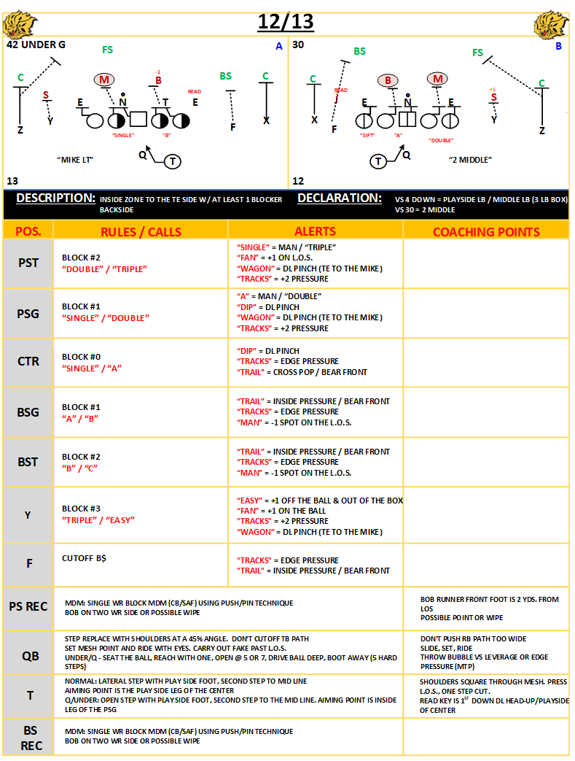

Slide 32
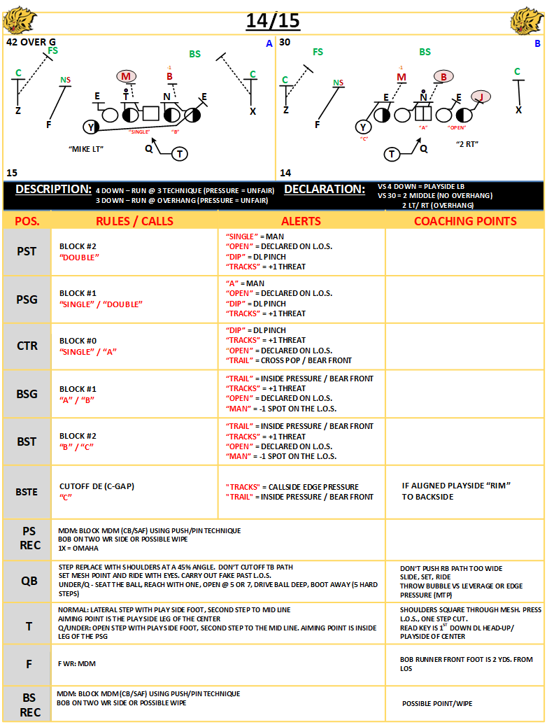

Slide 33
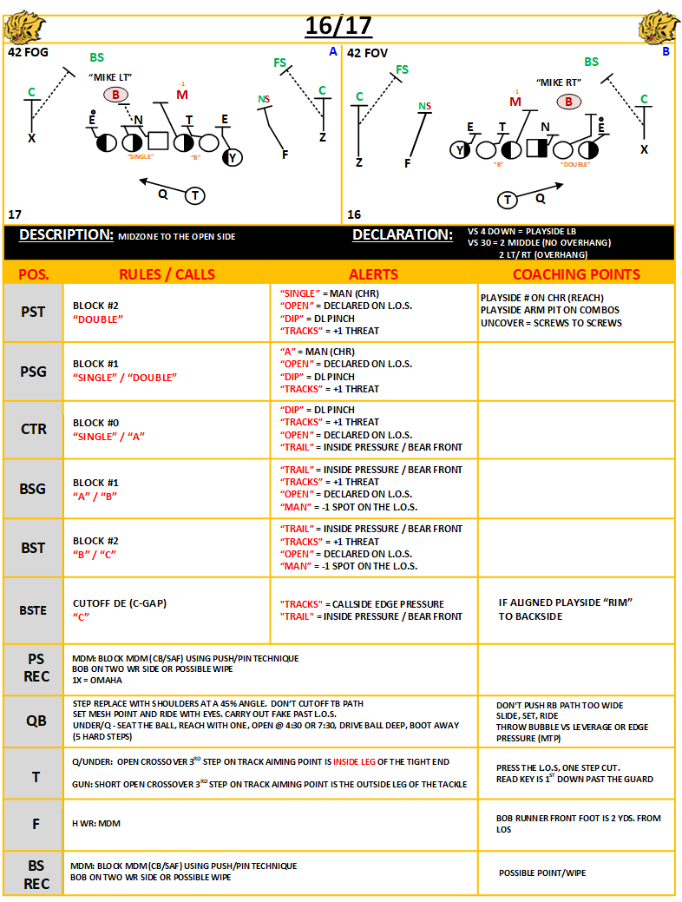

Slide 34
PASS PROTECTION
30/31: NAKED PAP PROTECTION
50/51: BASE 5 MAN PROTECTION
60/61: BASE 6 MAN PROTECTION
90/91: QUICK GAME GAP PROTECTION (red/black/firm)

Slide 35
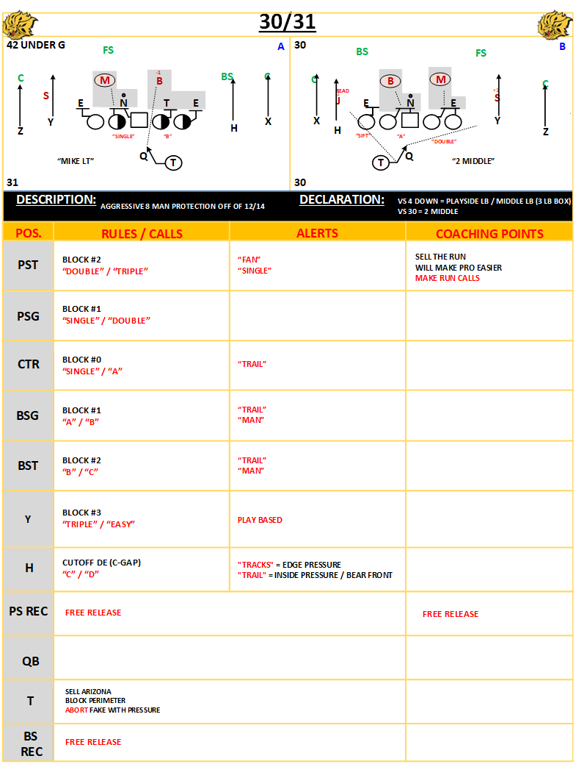

Slide 36
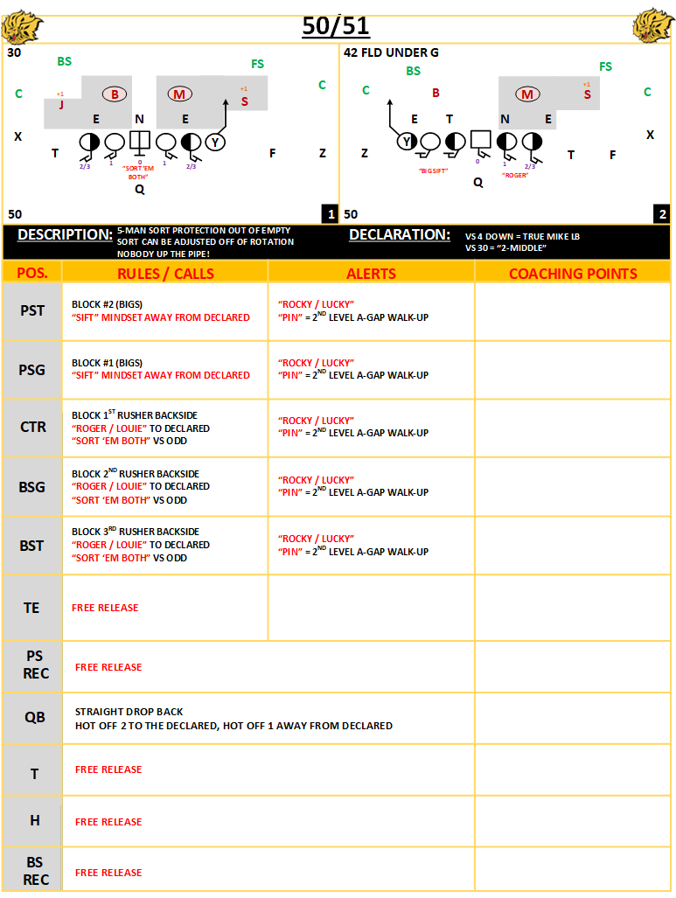

Slide 37
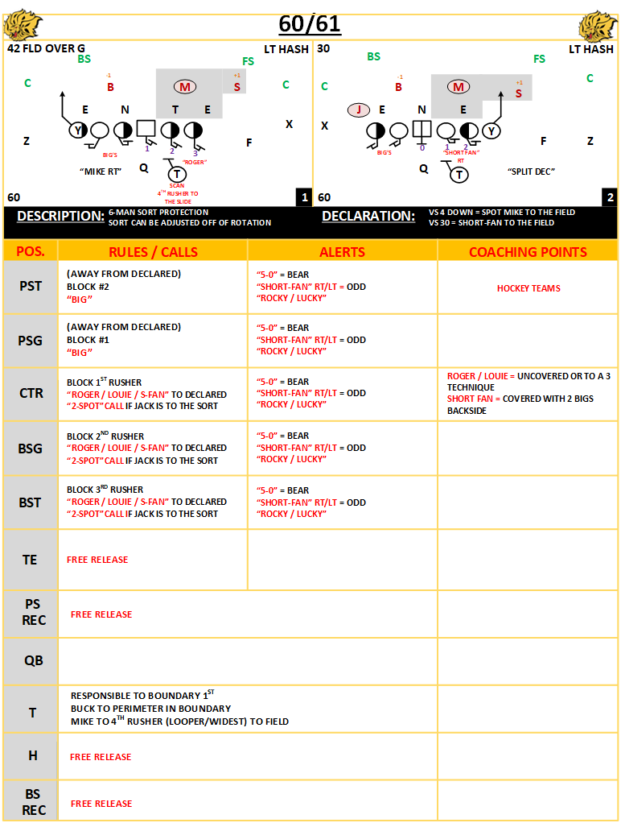

Slide 38
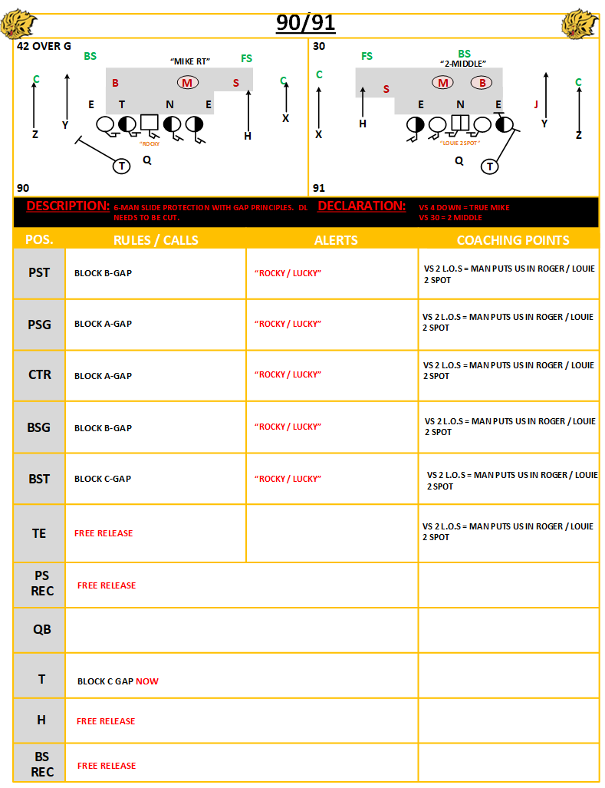

Slide 39
2023 PLAYBOOK
RUN-PASS TAGS

Slide 40
RUN-PASS TAGS
KEY GAME (1, 2, 3)
GIFT
STORM

Slide 41
2023 PLAYBOOK
KEY 1

Slide 44
2023 PLAYBOOK
KEY 2

Slide 47
2023 PLAYBOOK
KEY 3

Slide 49
2023 PLAYBOOK
gift

Slide 51
2023 PLAYBOOK
storm

Slide 52

STORM
MESH: INSIDE RUN / OUTSIDE RUNS
6 MAN BOX READ: nickel/sam
7 MAN BOX READ:
man beater tag
COACHING POINT:
TAKE FREE ACCESS.
X
Y
H
Z
tag
Q
GLANCE
SLANT
Key 1
T

Slide 53
2023 PLAYBOOK
Quick game

Slide 54
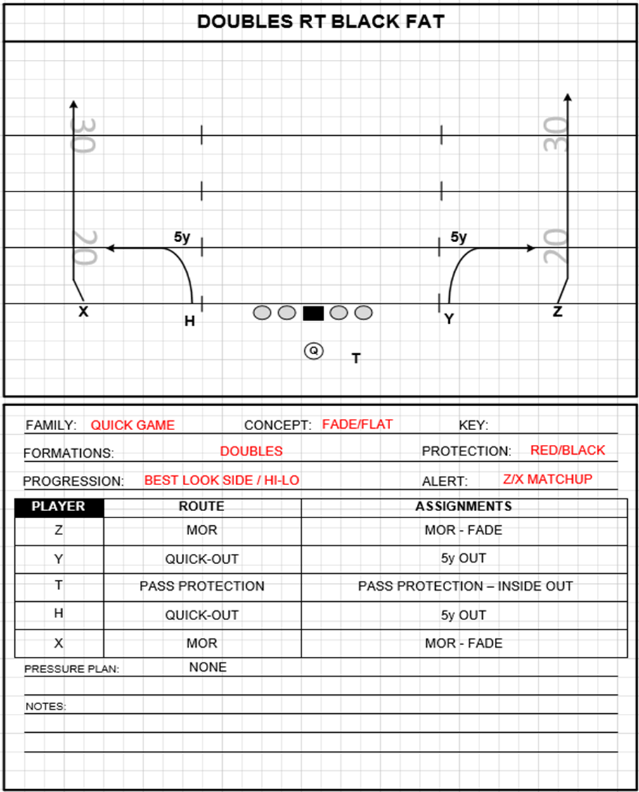

Slide 55
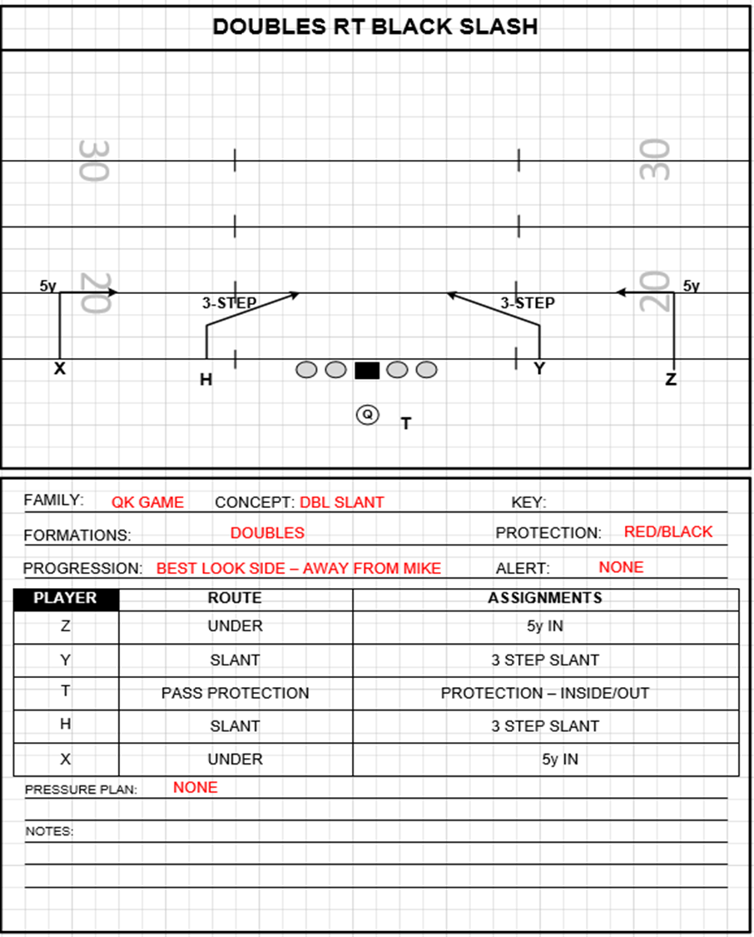

Slide 56
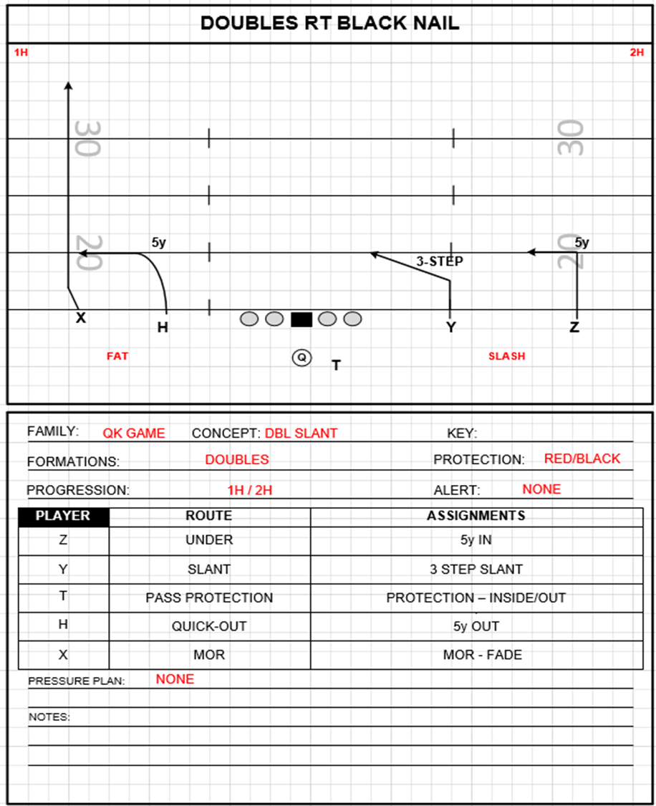

Slide 57
2023 PLAYBOOK
Gas stations

Slide 58
CHEVRON
3 MAN SNAG
PURE PROGRESSION CONCEPT
BACKSIDE TAGS – SLANTS
1 BACK PROTECTION – 50 / 51
2 BACK PROTECTION – 60 /61

Slide 59



Slide 61
2023 PLAYBOOK
exxon

Slide 63
2023 PLAYBOOK
Drop back

Slide 64
2023 PLAYBOOK
caddy

Slide 65
CADDY (tags)
CROSS
PURE PROGRESSION
PRE SNAP GO ROUTE BY 1
PROGRESSION IS WEAK SIDE FLAT ROUTE –CROSS-POST CURL-FLAT
1 BACK PROTECTION – 50/51
2 BACK PROTECTION – 60/61

Slide 68
2023 PLAYBOOK
daytona

Slide 69
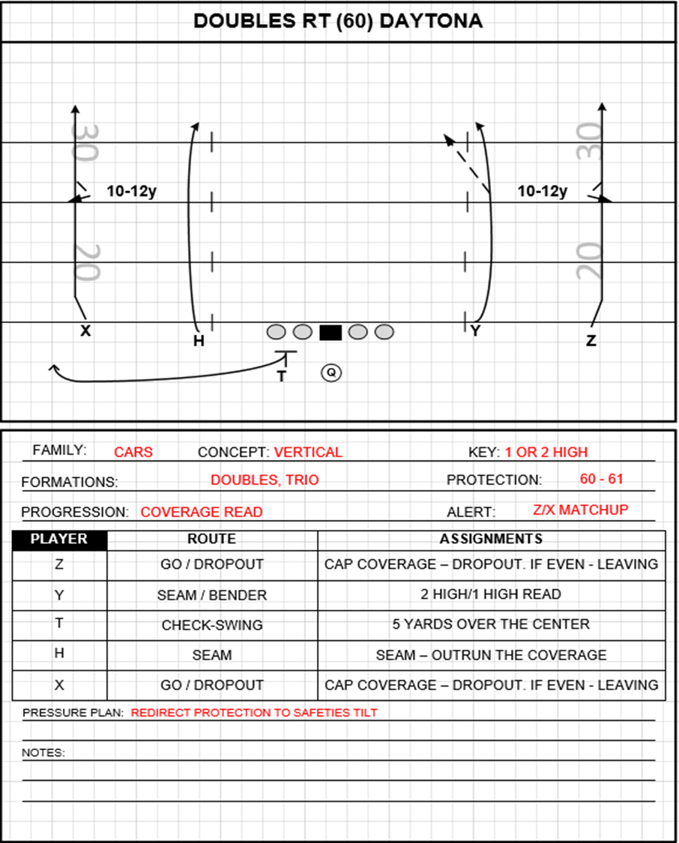

Slide 70
2023 PLAYBOOK
mtp

Slide 71
2023 PLAYBOOK
30/31

Slide 72
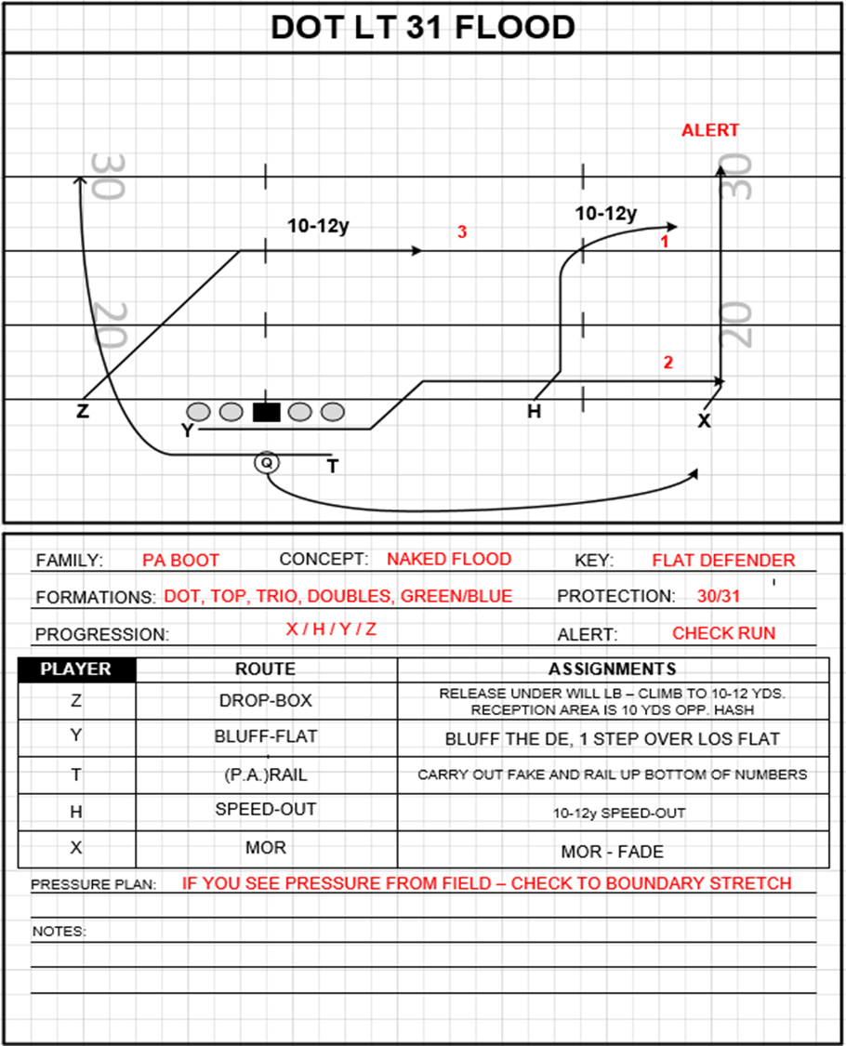

Slide 73
2023 PLAYBOOK
screens

Slide 74
2023 PLAYBOOK
rose

Slide 75
