Slide 1
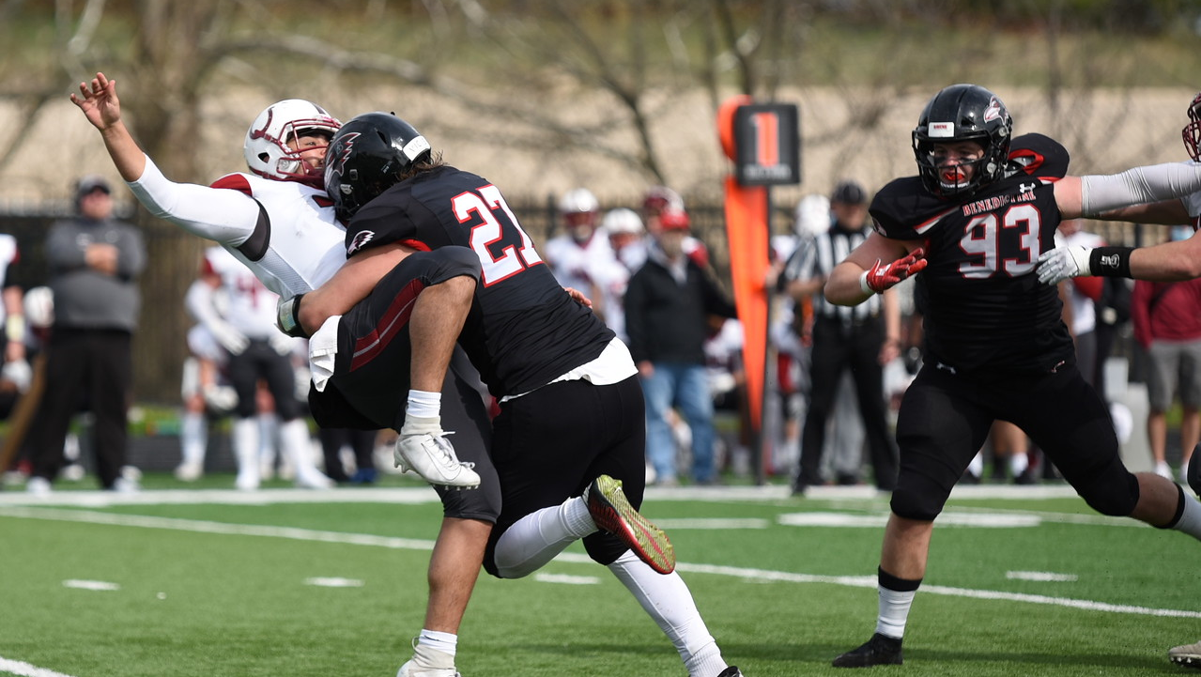
A Modular Pressure System for All Coverages and Formations
Andy Merfeld

Slide 2
A Modular Pressure System
Andy Merfeld
608-279-6899
AndyMerfeld@gmail.com

Slide 3
A Modular Pressure System
What is it?
A way to easily adjust your blitzes based on the formation
We will focus on edge blitzes since interior alignments are usually more static and predictable
Edge blitzer can change, coverage and interior rushers stay the same
Notes:
Pressure structure
Based on how you align
Strong pressure to add guy to the run fit and shore up that edge
DL using BFRs

Slide 4
A Modular Pressure System
Why?
Disguise – hold your normal look
Better pressure – get the blitzer closer to his gap
Account for all formations – never have to worry about not liking a blitz against a certain look
Passing strength: Star blitz unless #3 is detached
Away: FS blitz unless #2 is detached or #1 is tight

Slide 5
Formation and Split Adjustments
Deep safety to that side always takes the blitzer’s coverage
Bingo = “Backer Inside Go”
#3 detached strong side or #2 detached weak
Sinbad = deep safety blitz
Default to weak side, or if #2 strong is very wide
Cobra = corner blitz
#1 weak is a TE (or WR with very tight split)
Limbo = backer over #4 blitz
4x1, #4 detached
Notes:
1 detached
2 detached (motion away)
3 detached (motion away)
Nub TE or reduced split

Slide 6
Passing strength: star go (default)
Q
V
V
V
V
*
M
W
C
C
SS
FS
Common strong side pressure coverages:
Rush 4: Cover 3 creeper or simulated pressure
Rush 4: Cover 2 creeper or simulated pressure
Rush 5: Fire zone (3D3U or 2D4U)
Rush 6: Cover 0

Slide 7
Passing strength: star go (default)
Q
c
C
*
V
V
V
V
M
W
C
SS
FS
Common strong side pressure coverages:
Rush 4: Cover 3 creeper or simulated pressure
Rush 4: Cover 2 creeper or simulated pressure
Rush 5: Fire zone (3D3U or 2D4U)
Rush 6: Cover 0

Slide 8
Passing strength: “Sinbad” vs. #2 wide
Q
V
V
V
V
*
M
W
C
C
SS
FS
“Sinbad”
Common strong side pressure coverages:
Rush 4: Cover 3 creeper or simulated pressure
Rush 4: Cover 2 creeper or simulated pressure
Rush 5: Fire zone (3D3U or 2D4U)
Rush 6: Cover 0

Slide 9
Passing strength: “Bingo” vs. #3 Detached
Q
V
V
V
V
*
M
W
C
C
C
SS
FS
“Bingo”
Common strong side pressure coverages:
Rush 4: Cover 3 creeper or simulated pressure
Rush 4: Cover 2 creeper or simulated pressure
Rush 5: Fire zone (3D3U or 2D4U)
Rush 6: Cover 0

Slide 10
Passing strength: “Limbo” vs. #4 Detached
Q
V
V
V
V
*
M
W
C
C
SS
FS
“Limbo”
Common strong side pressure coverages:
Rush 4: Cover 3 creeper or simulated pressure
Rush 4: Cover 2 creeper or simulated pressure
Rush 5: Fire zone (3D3U or 2D4U)
Rush 6: Cover 0

Slide 11
Passing strength: 2 FROM A SIDE
Q
V
V
V
V
*
M
W
C
C
SS
FS
Common strong side pressure coverages:
Rush 5: Fire zone (3D3U or 2D4U)
Rush 6: Cover 0
Rush 6: 3 Deep, 2 Under

Slide 12
Passing strength: 2 FROM A SIDE vs. #3 Detached
Q
V
V
V
V
*
M
W
C
C
C
SS
FS
“Bingo”
Common strong side pressure coverages:
Rush 5: Fire zone (3D3U or 2D4U)
Rush 6: Cover 0
Rush 6: 3 Deep, 2 Under
Notes:
3D2U gets a little messy because you are bingo-ing it

Slide 13
away: fs go (default)
Q
V
V
V
V
*
M
W
C
C
SS
FS
Common weak side pressure coverages:
Rush 4: Cover 2 creeper or simulated pressure
Rush 5: Fire zone (3D3U)
Rush 5: man-match quarters strong, cover 0 weak
Rush 6: Cover 0

Slide 14
away: “Bingo” vs. #2 detached
Q
V
V
V
V
*
M
W
C
C
C
SS
FS
“Bingo”
Common weak side pressure coverages:
Rush 4: Cover 2 creeper or simulated pressure
Rush 5: Fire zone (3D3U)
Rush 5: man-match quarters strong, cover 0 weak
Rush 6: Cover 0

Slide 15
away: “Cobra” vs. #1 tight
Q
V
V
V
V
V
*
M
W
C
C
C
C
SS
FS
“Cobra”
Common weak side pressure coverages:
Rush 4: Cover 2 creeper or simulated pressure
Rush 5: Fire zone (3D3U)
Rush 5: man-match quarters strong, cover 0 weak
Rush 6: Cover 0

Slide 16
Motion Adjustments
Bingo turns into a Sinbad on motion away
Motion to pressure side = don’t change pressure unless he sets up
Getting to a “bingo” changes three players’ responsibilities.
Notes:
Late cobras?

Slide 17
Passing strength: “Bingo” to “Sinbad” on motion
Q
V
V
V
V
*
M
W
C
C
C
SS
FS
“Bingo”
“Sinbad”

Slide 18
away: “Bingo” to “Sinbad” on motion
Q
V
V
V
V
*
M
W
C
C
C
SS
FS
“Bingo”
“Sinbad”

Slide 19
DO NOT “BINGO” UNLESS MOTION SETS UP
Q
V
V
V
V
*
M
W
C
C
SS
FS

Slide 20
Blitz Responsibilities
Checking blitzer within the same call means that the responsibilities and reads must be the same
Also allows you to use the same blitz technique in different calls
Creeper cover 3
Fire zone 3 deep, 3 under
Creeper Tampa 2
Cover 0
Etc.
Odd spacing, edge blitzer as force player
Notes:
X path? Mention/show somewhere
Use same blitz responsibilities in different calls (run fit spacing, zone and man pressures, sims etc)
Coverages to touch on:
1/10?
2 sim
2D4U
3/6
5 sim?
70
9
0
Area

Slide 21
Q
V
V
V
V
*
M
W
C
C
SS
FS
Front: Odd Spacing
Edge blitzer force vs. spill

Slide 22
Priorities on Edge blitz
1. Do your job
Against run, set the edge and keep the ball inside. Take the high/outside element vs. option
Against pass, contain the QB. Keep the ball inside and in front (don’t run off the cliff)
2. Help other guys do their jobs
Against run, constrict the running alley as much as possible
Rip vs. shock vs. gladiator
Don’t run off the cliff
Against pass, speed up the QB and affect the throw
Match the hand when he pulls the pin and run through his chest
If you jump, you’d better get a hand on the ball
3. Make the play

Slide 23
Edge blitz vs. Run Thought Process
1. Is there a C area player blocking you?
If yes: power press, set the edge & constrict the running lane
2. If no C area player blocking you, be ready for a kickout block from a puller or fullback/swiper
If kickout: gladiator, set the edge & constrict the running lane
3. If no kickout, see RB action
Against any option look at you, take the outside piece.
If RB is coming to you, make the play
If the RB is going away from you, surf & play the C/D gap
Surf = quarterback to cutback

Slide 24
Edge blitz vs. Run Thought Process
1. Is there a C area player blocking you?
If yes: power press, set the edge & constrict the running lane
2. If no C area player blocking you, be ready for a kickout block from a puller or fullback/swiper
3. If no kickout, see RB action

Slide 25
Edge blitz vs. Run Thought Process
1. Is there a C area player blocking you?
If yes: power press, set the edge & constrict the running lane
2. If no C area player blocking you, be ready for a kickout block from a puller or fullback/swiper
If kickout: gladiator, set the edge & constrict the running lane
3. If no kickout, see RB action

Slide 26
Edge blitz vs. Run Thought Process
1. Is there a C area player blocking you?
If yes: power press, set the edge & constrict the running lane
2. If no C area player blocking you, be ready for a kickout block from a puller or fullback/swiper
If kickout: gladiator, set the edge & constrict the running lane
3. If no kickout, see RB action
Against any option look at you, take the outside piece
If RB is coming to you, make the play
If the RB is going away from you, surf & play the C/D gap
Surf = quarterback to cutback

Slide 27
Edge blitz vs. Run Thought Process
1. Is there a C area player blocking you?
If yes: power press, set the edge & constrict the running lane
2. If no C area player blocking you, be ready for a kickout block from a puller or fullback/swiper
If kickout: gladiator, set the edge & constrict the running lane
3. If no kickout, see RB action
Against any option look at you, take the outside piece
If RB is coming to you, make the play
If the RB is going away from you, surf & play the C/D gap
Surf = quarterback to cutback

Slide 28
Edge blitz vs. Run Thought Process
1. Is there a C area player blocking you?
If yes: power press, set the edge & constrict the running lane
2. If no C area player blocking you, be ready for a kickout block from a puller or fullback/swiper
If kickout: gladiator, set the edge & constrict the running lane
3. If no kickout, see RB action
Against any option look at you, take the outside piece
If RB is coming to you, make the play
If the RB is going away from you, surf & play the C/D gap
Surf = quarterback to cutback

Slide 29
Priorities on Edge blitz
1. Do your job
Against run, set the edge and keep the ball inside. Take the high/outside element vs. option
Against pass, contain the QB. Keep the ball inside and in front (don’t run off the cliff)
2. Help other guys do their jobs
Against run, constrict the running alley as much as possible
Rip vs. shock vs. gladiator
Don’t run off the cliff
Against pass, speed up the QB and affect the throw
Match the hand when he pulls the pin and run through his chest
If you jump, you’d better get a hand on the ball
3. Make the play

Slide 30
Edge blitz vs. Pass Thought Process
Three categories of pass rush moves: speed, power, finesse
1. Think speed first always! If you are unblocked:
Do your job: contain the QB – keep the ball inside and in front
Help other guys do their job: If you can’t get home, speed up the QB and affect the throw
Match the hand when he pulls the pin and run through his chest
If you jump, you’d better get a hand on the ball
If you CAN get home:
With the QB looking at you, think sprint to shimmy
If the QB can’t see you, think strip-sack

Slide 31
Edge blitz vs. Pass Thought Process
Three categories of pass rush moves: speed, power, finesse
2. It will usually be the RB or OT responsible for you in protection
You can stay with speed if the RB steps up too far or the OT is late picking you up
Speed rush: Dip-rip-lean-reach. Reach with your outside arm to flip your hips and get your toes pointed towards the QB

Slide 32
Edge blitz vs. Pass Thought Process
Three categories of pass rush moves: speed, power, finesse
3. If the blocker is deep and close to the QB, convert speed to power. He’s passive, we are aggressive
Bull rush: Two-hand strike and push the blocker back into the QB.
Counter: Push-Pull once you feel the blocker sit it down and lean into you.

Slide 33
Edge blitz vs. Pass Thought Process
Three categories of pass rush moves: speed, power, finesse
4. If the OT sees you early, a speed move will be difficult. He’s aggressive, we are finesse
Reaction: Bob-Rip or Bob-Wipers
Head bob to threaten him inside and stop his kick-slide, use rip or wipers to get his hands off, then flip hips and dip-rip-lean-reach.

Slide 34
The Cliff
Three categories of pass rush moves: speed, power, finesse
5. When approaching the cliff: (set up your) spin back inside
Spin is the counter for all moves, same as vs. run
Sit on the barstool and ice pick him in the back
Do not spin too early!

Slide 35
Unclear Run vs. Pass
It is more difficult with run action AT you and easier with the run action away from you (since you should be surfing for the QB anyway on run action away)
Usually think run first and react to pass
Could vary depending on situation and call
Above all else, we know we need to keep the ball inside and avoid running off the cliff

Slide 36
Second Effort

Slide 37
‘X’ Path
Coaching points:

